Slide 1
MPOPF Simulation and OpenDSS Validation
Aryan Ritwajeet Jha
Graduate Research Assistant
Washington State University
Notes:
Remember to hit the reset button to make sure all the page elements react properly.
There are 20 different layouts that you can choose from.

Slide 2
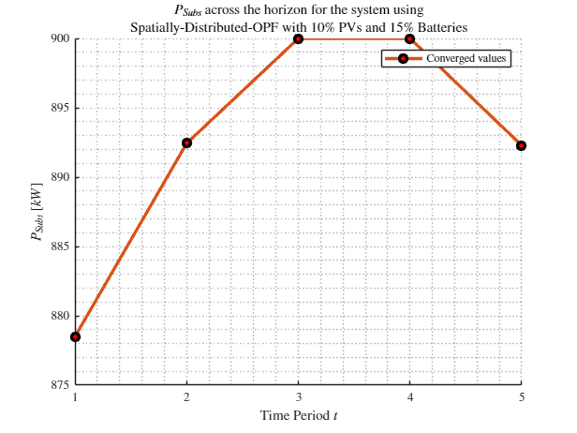
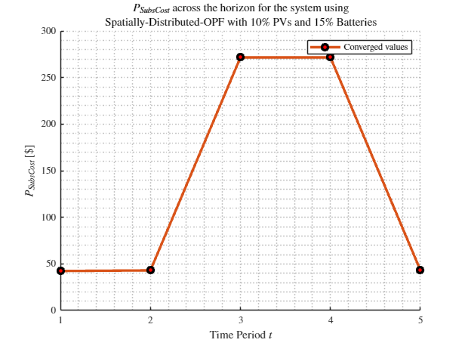
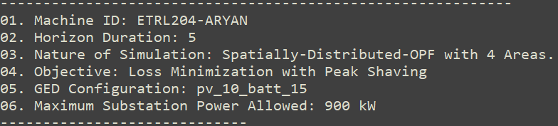
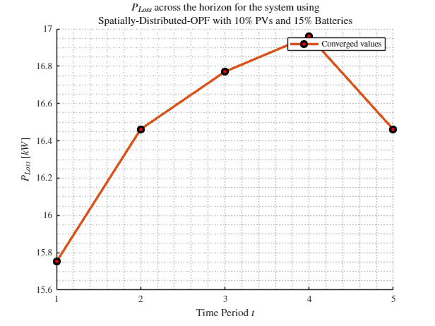
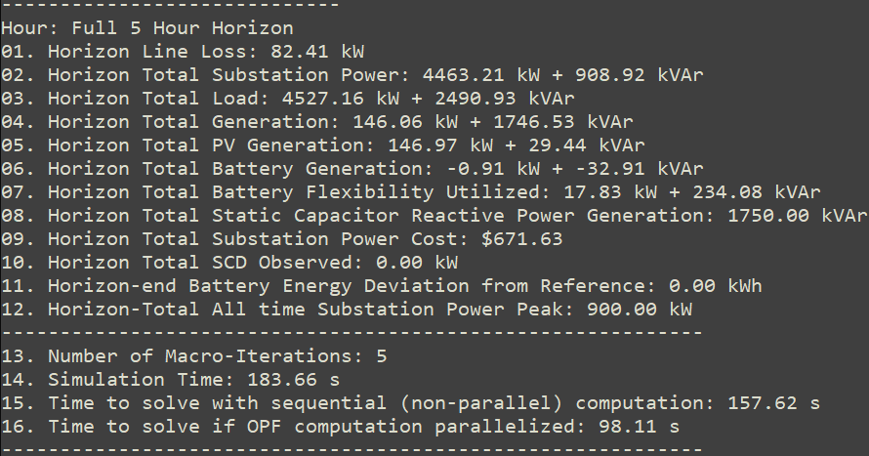
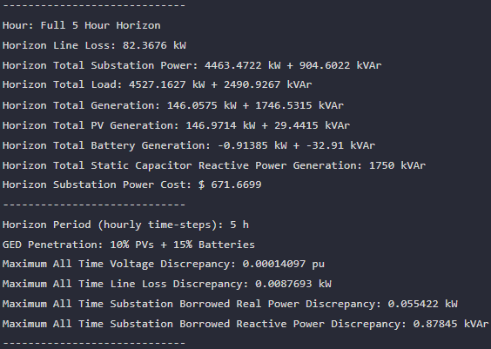

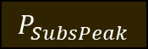



MPDOPF Verified for $T=5, PV=0\%, Batt=0\%$
strLoadShapeCost = 'New Loadshape.LoadShapeCost npts =5 interval = 1 mult = [0.048204 0.048204 0.30181 0.30181 0.048204]'
$P_{Subs}^{t}$
$P_{SubsCost}^{t}$
OpenDSS Def Profiles
Gen Cost+ Peak Shave
OpenDSS Powerflow Results
$$P_{Loss}^{t}$$
MPDOPF Simulation Results
Objective
$$P_{SubsPeak}$$
Timings
Discrepancies

Slide 3
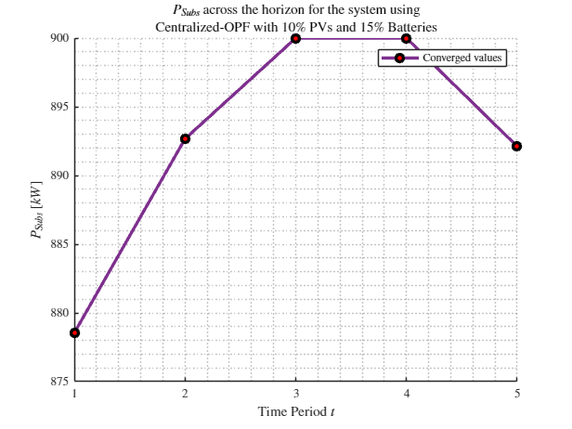
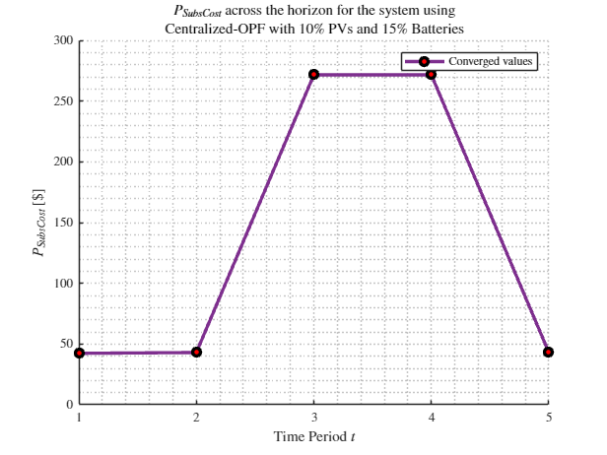
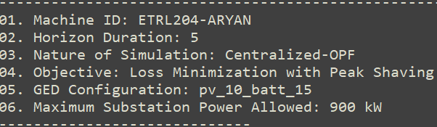
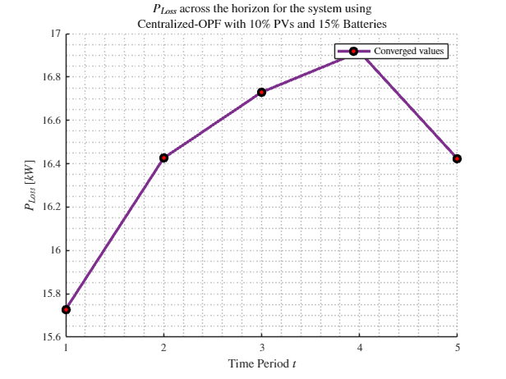
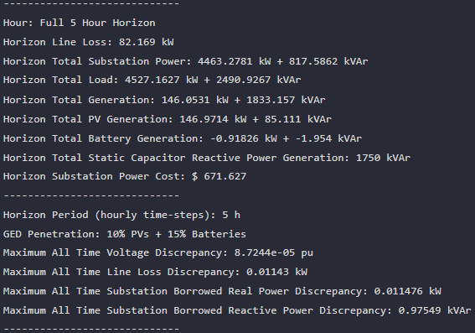



MPCOPF Verified for $T=5, PV=0\%, Batt=0\%$
strLoadShapeCost = 'New Loadshape.LoadShapeCost npts =5 interval = 1 mult = [0.048204 0.048204 0.30181 0.30181 0.048204]'
$P_{Subs}^{t}$
$P_{SubsCost}^{t}$
OpenDSS Def Profiles
Gen Cost + Peak Shave
OpenDSS Powerflow Results
$$P_{Loss}^{t}$$
MPDOPF Simulation Results
Objective
$$P_{SubsPeak}$$
Timings
Discrepancies

Slide 4
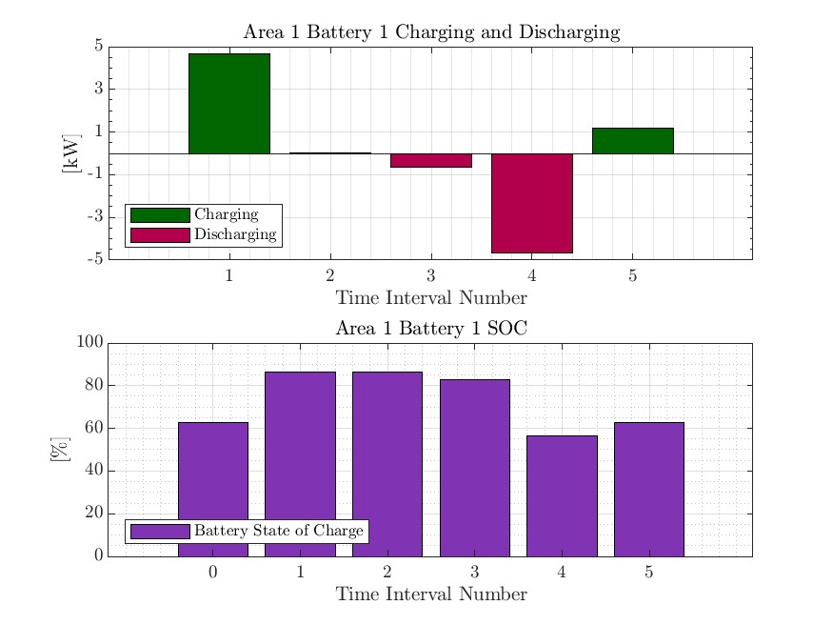
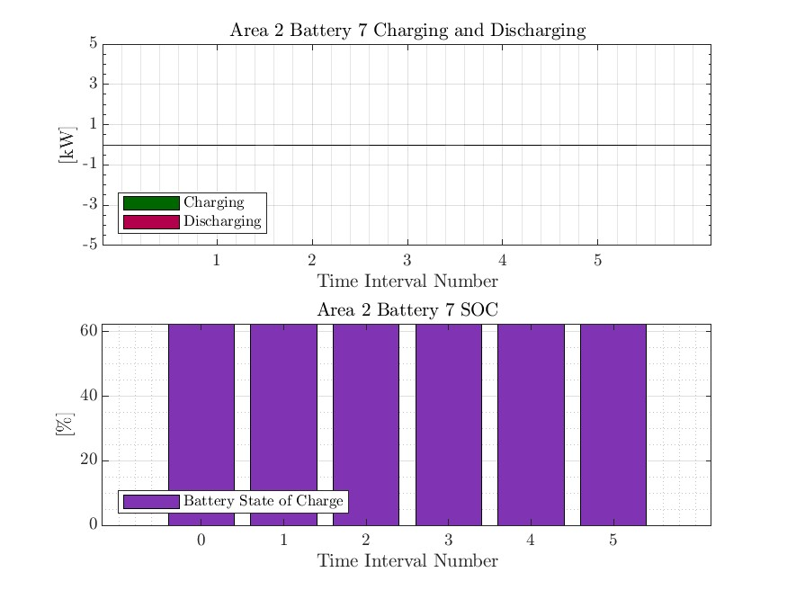



MPDOPF Verified for $T=5, PV=0\%, Batt=0\%$
strLoadShapeCost = 'New Loadshape.LoadShapeCost npts =5 interval = 1 mult = [0.048204 0.048204 0.30181 0.30181 0.048204]'
OpenDSS Def Profiles
Gen Cost + Peak Shave

Slide 5

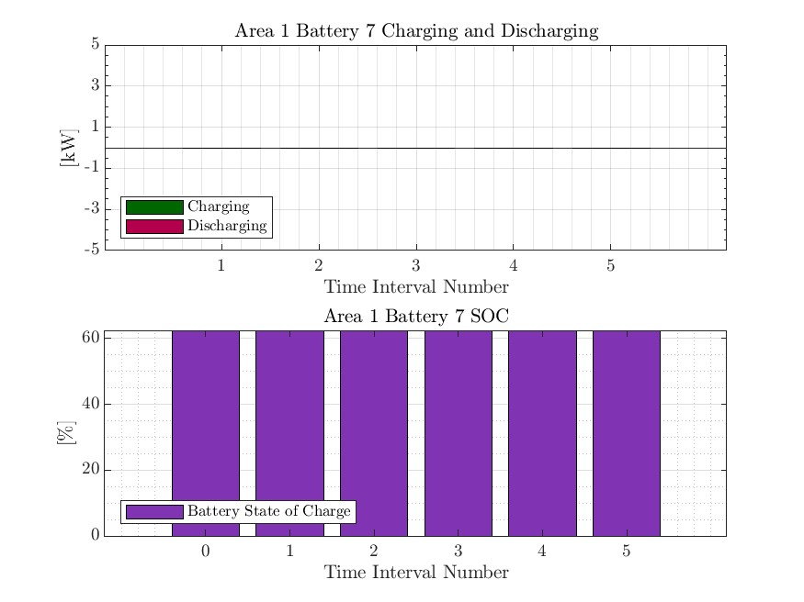
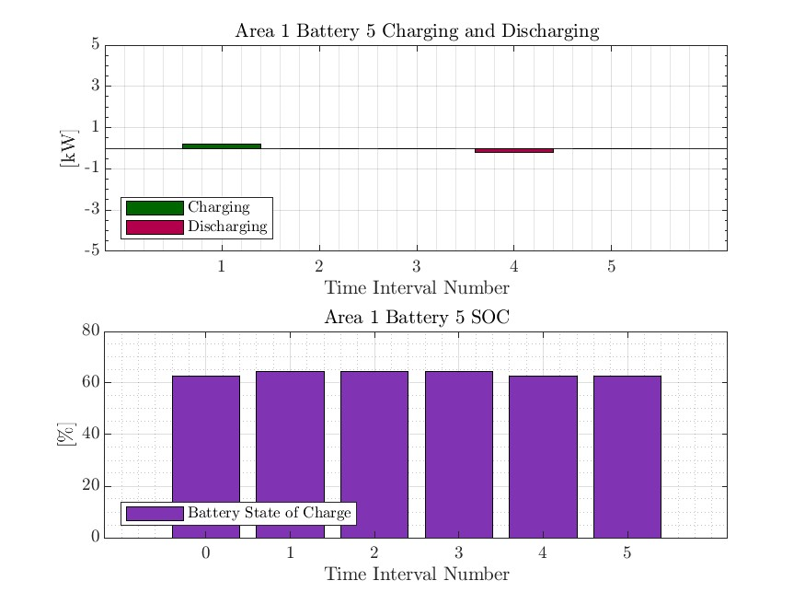


MPCOPF Verified for $T=5, PV=0\%, Batt=0\%$
strLoadShapeCost = 'New Loadshape.LoadShapeCost npts =5 interval = 1 mult = [0.048204 0.048204 0.30181 0.30181 0.048204]'
OpenDSS Def Profiles
Gen Cost + Peak Shave

Slide 6

MPDOPF Verified for $T=5, PV=10\%, Batt=15\%$
strLoadShapeCost = 'New Loadshape.LoadShapeCost npts =5 interval = 1 mult = [0.048204 0.048204 0.30181 0.30181 0.048204]'
$P_{Subs}^{t}$
$P_{SubsCost}^{t}$
OpenDSS Def Profiles
Gen Cost + Peak Shave
OpenDSS Powerflow Results
$$P_{Loss}^{t}$$
MPDOPF Simulation Results
Objective
$$P_{SubsPeak}$$
Timings
Discrepancies

Slide 7

MPCOPF Verified for $T=5, PV=10\%, Batt=15\%$
strLoadShapeCost = 'New Loadshape.LoadShapeCost npts =5 interval = 1 mult = [0.048204 0.048204 0.30181 0.30181 0.048204]'
$P_{Subs}^{t}$
$P_{SubsCost}^{t}$
OpenDSS Def Profiles
Gen Cost + Peak Shave
OpenDSS Powerflow Results
$$P_{Loss}^{t}$$
MPDOPF Simulation Results
Objective
$$P_{SubsPeak}$$
Timings
Discrepancies

Slide 8

MPDOPF Verified for $T=5, PV=10\%, Batt=15\%$
strLoadShapeCost = 'New Loadshape.LoadShapeCost npts =5 interval = 1 mult = [0.048204 0.048204 0.30181 0.30181 0.048204]'
OpenDSS Def Profiles
Gen Cost + Peak Shave

Slide 9

MPCOPF Verified for $T=5, PV=10\%, Batt=15\%$
strLoadShapeCost = 'New Loadshape.LoadShapeCost npts =5 interval = 1 mult = [0.048204 0.048204 0.30181 0.30181 0.048204]'
OpenDSS Def Profiles
Gen Cost + Peak Shave

Slide 10
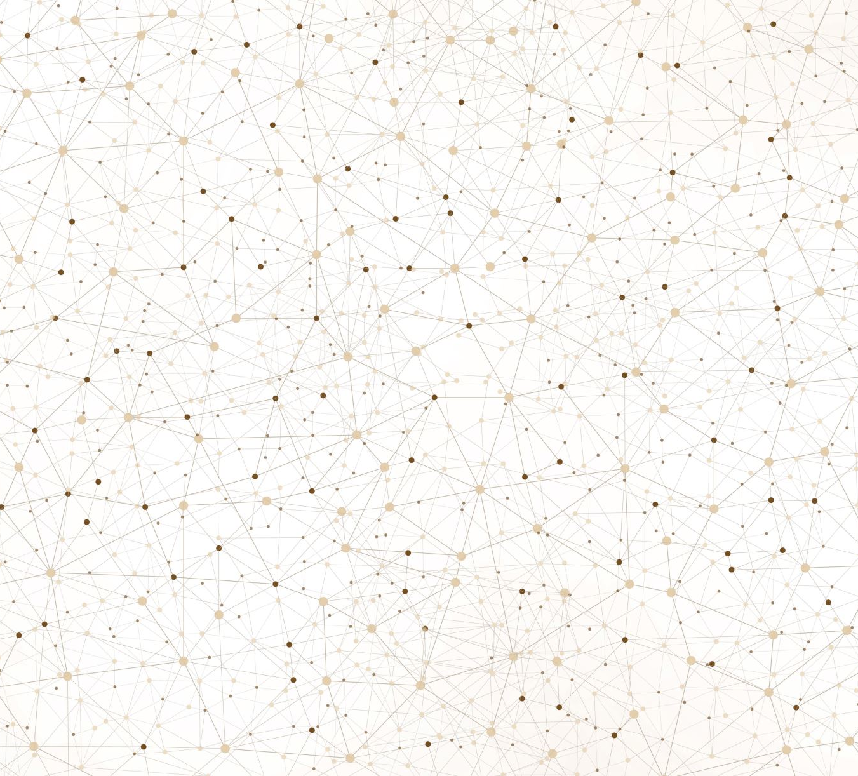
Latest Slides End Here.
Previous Slides Follow

Slide 11
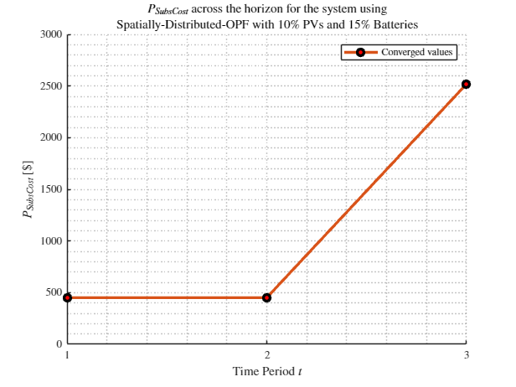
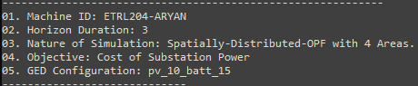
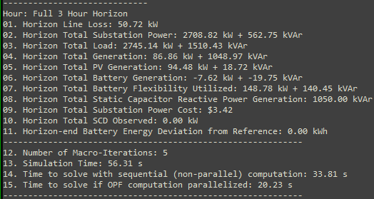
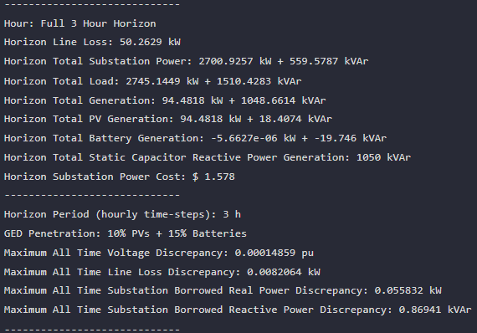

MPDOPF Verified for $T=3, PV=10\%, Batt=15\%$
strLoadShapeCost = 'New Loadshape.LoadShapeCost npts =3 interval = 1 mult = [0.048204 0.048204 0.30181]'
OpenDSS Def Profiles
Gen Cost
MPDOPF Simulation Results
OpenDSS Powerflow Results
Timings
Discrepancies

Slide 12
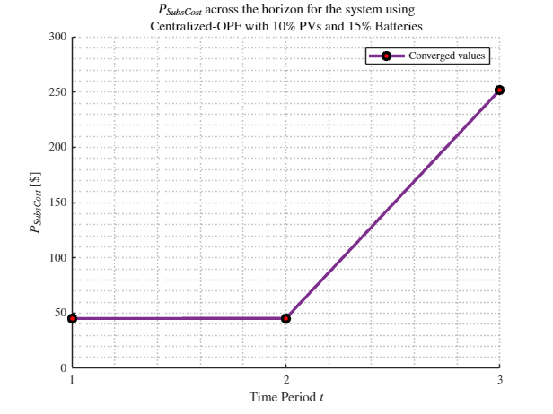
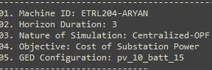
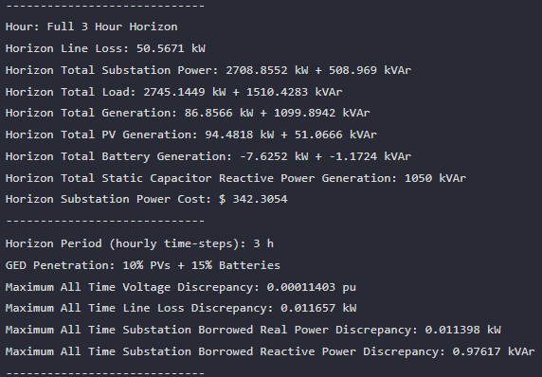
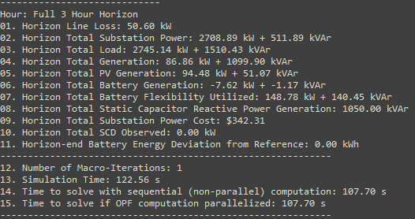

MPCOPF Verified for $T=3, PV=10\%, Batt=15\%$
strLoadShapeCost = 'New Loadshape.LoadShapeCost npts =3 interval = 1 mult = [0.048204 0.048204 0.30181]'
OpenDSS Def Profiles
Gen Cost
MPDOPF Simulation Results
OpenDSS Powerflow Results
Timings
Discrepancies

Slide 13
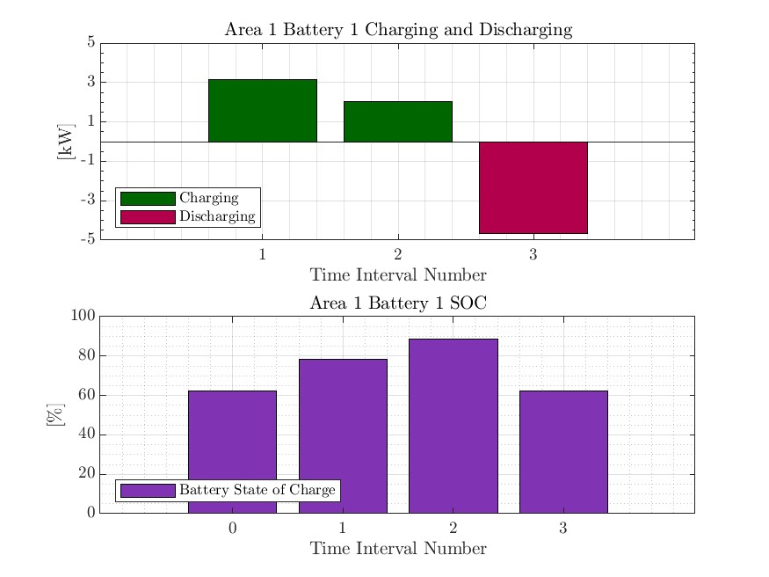
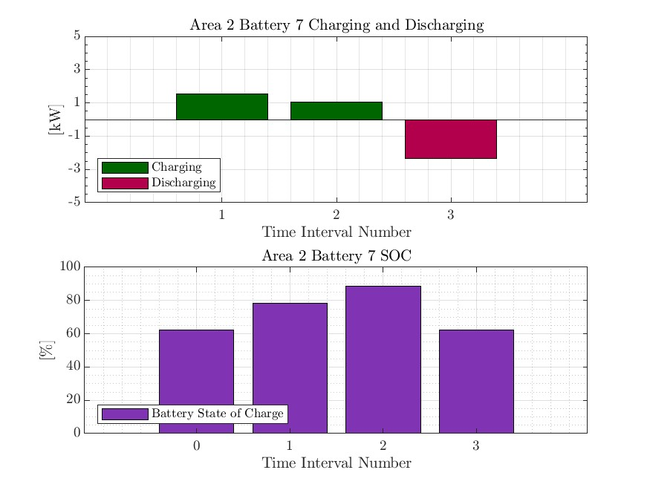
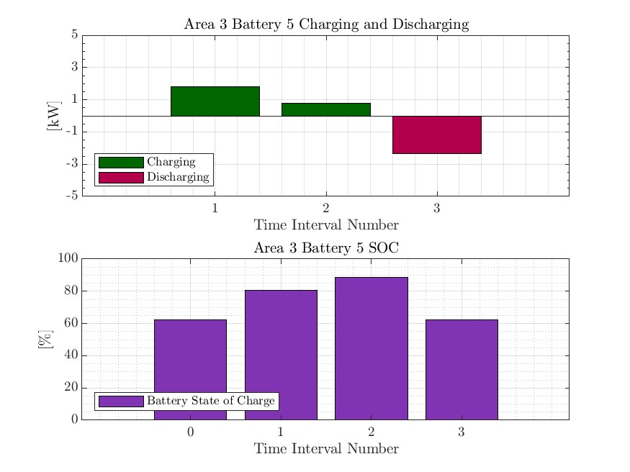
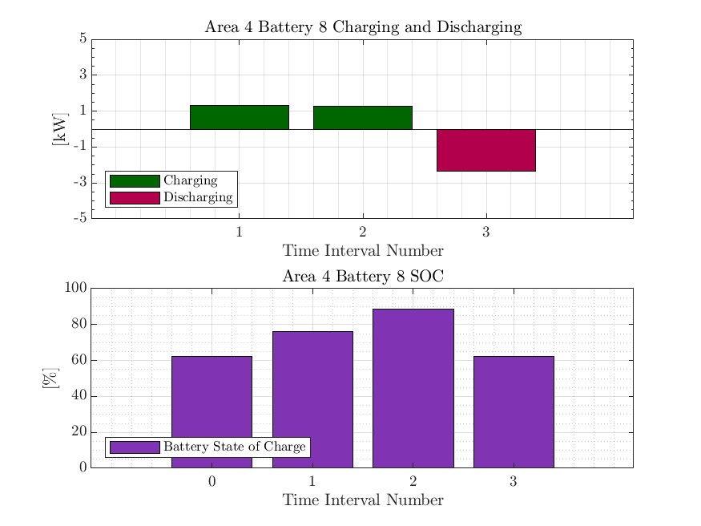

MPDOPF Verified for $T=3, PV=10\%, Batt=15\%$
strLoadShapeCost = 'New Loadshape.LoadShapeCost npts =3 interval = 1 mult = [0.048204 0.048204 0.30181]'
OpenDSS Def Profiles
Gen Cost

Slide 14
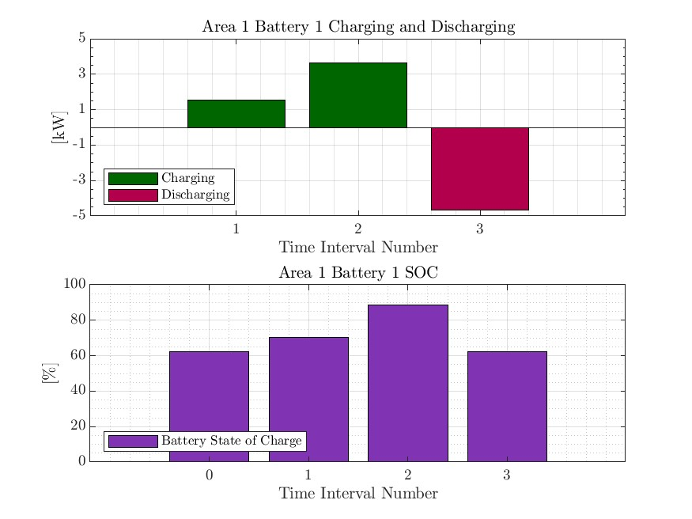

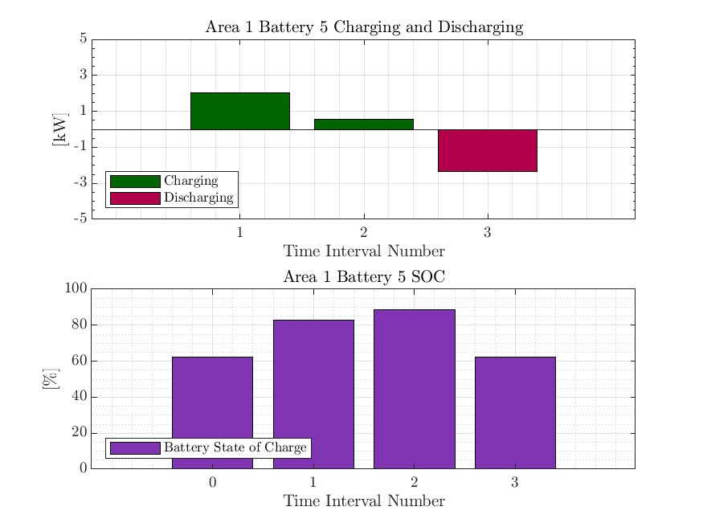


MPCOPF Verified for $T=3, PV=10\%, Batt=15\%$
strLoadShapeCost = 'New Loadshape.LoadShapeCost npts =3 interval = 1 mult = [0.048204 0.048204 0.30181]'
OpenDSS Def Profiles
Gen Cost

Slide 15
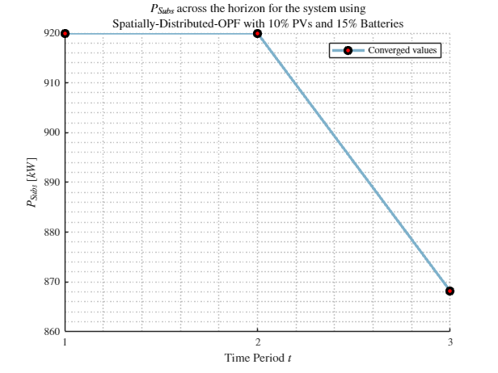
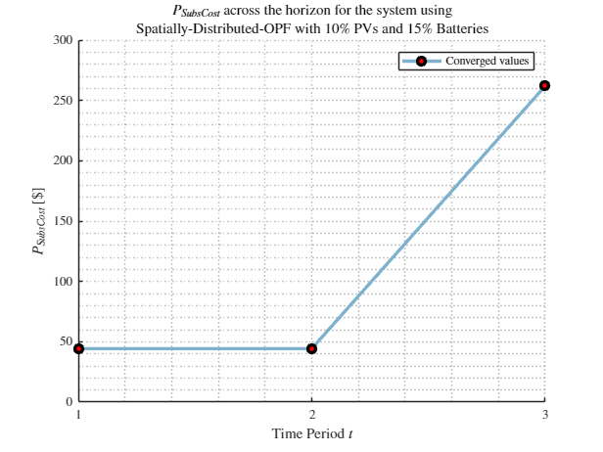
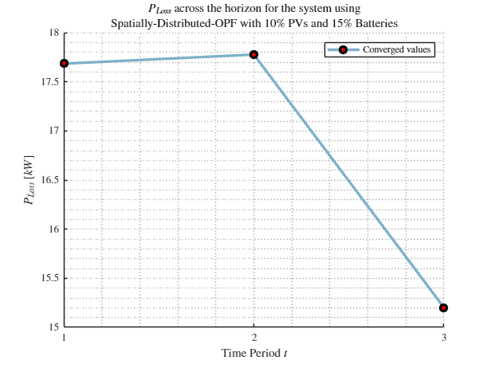
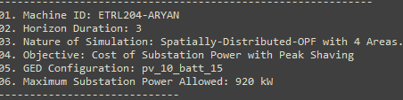
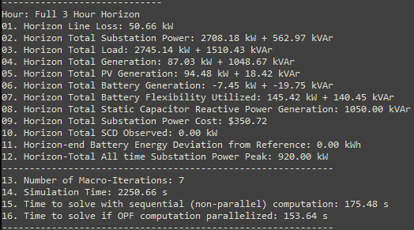
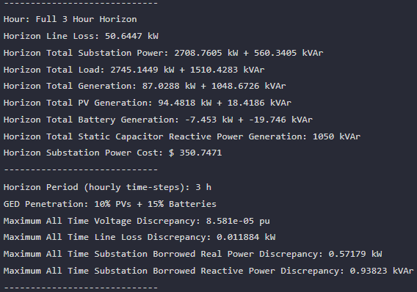
MPDOPF Verified for $T=3, PV=10\%, Batt=15\%$
strLoadShapeCost = 'New Loadshape.LoadShapeCost npts =3 interval = 1 mult = [0.048204 0.048204 0.30181]'
$P_{Subs}^{t}$
$P_{SubsCost}^{t}$
OpenDSS Def Profiles
Gen Cost + Peak Shave
OpenDSS Powerflow Results
$$P_{Loss}^{t}$$
MPDOPF Simulation Results
Timings
Discrepancies

Slide 16
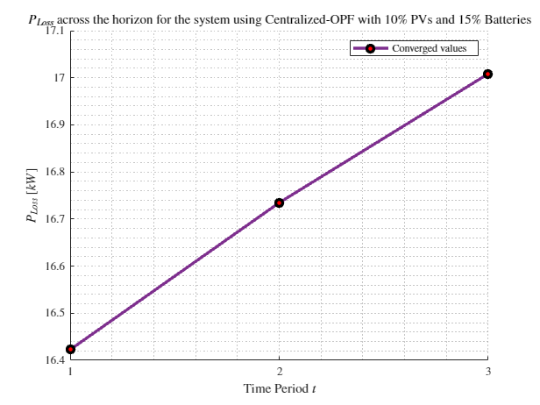
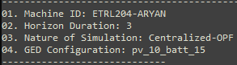
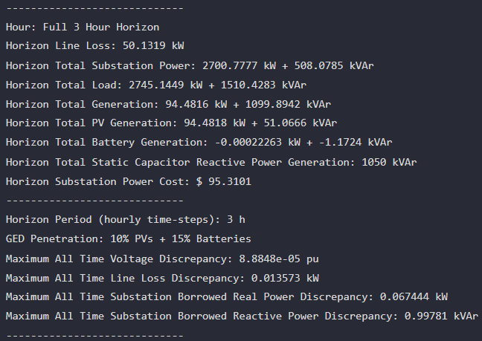
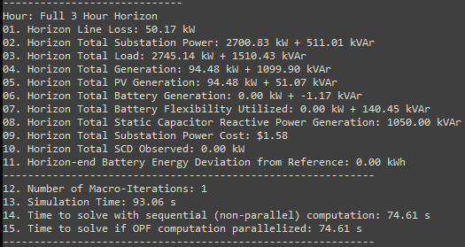
MPCOPF Verified for $T=3, PV=10\%, Batt=15\%$
strLoadShapeCost = 'New Loadshape.LoadShapeCost npts =3 interval = 1 mult = [0.048204 0.048204 0.30181]'
OpenDSS Def Profiles
Gen Cost + Peak Shave
MPDOPF Simulation Results
OpenDSS Powerflow Results
Timings
Discrepancies

Slide 17
MPDOPF Verified for $T=3, PV=10\%, Batt=15\%$
strLoadShapeCost = 'New Loadshape.LoadShapeCost npts =3 interval = 1 mult = [0.048204 0.048204 0.30181]'
OpenDSS Def Profiles
Gen Cost + Peak Shave

Slide 18
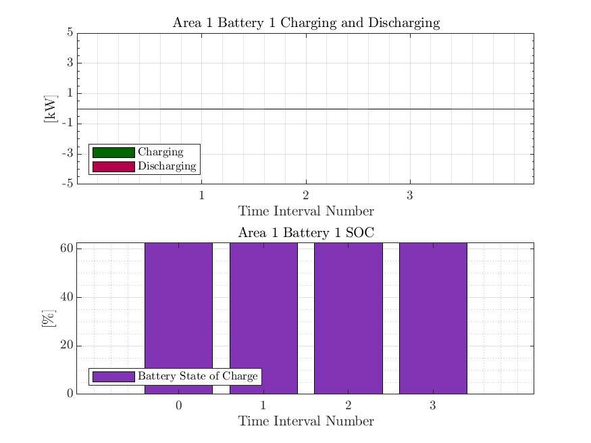



MPCOPF Verified for $T=3, PV=10\%, Batt=15\%$
strLoadShapeCost = 'New Loadshape.LoadShapeCost npts =3 interval = 1 mult = [0.048204 0.048204 0.30181]'
OpenDSS Def Profiles
Gen Cost + Peak Shave

Slide 19
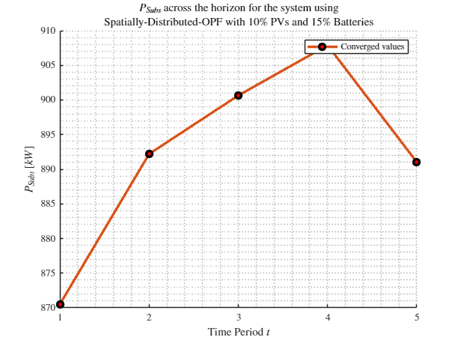

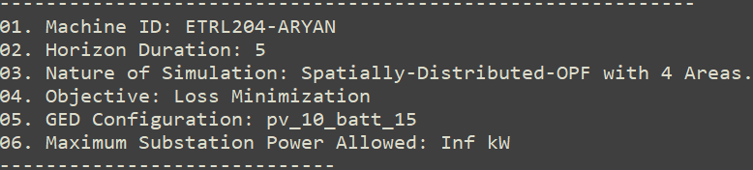
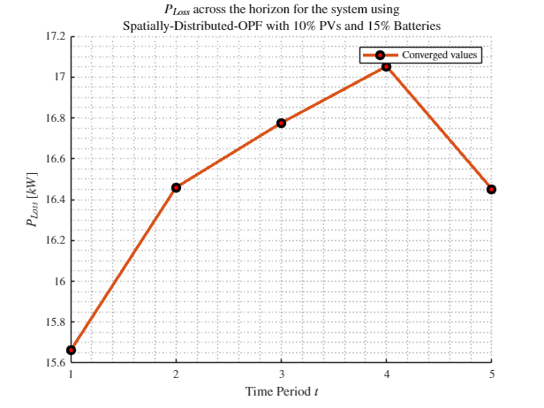

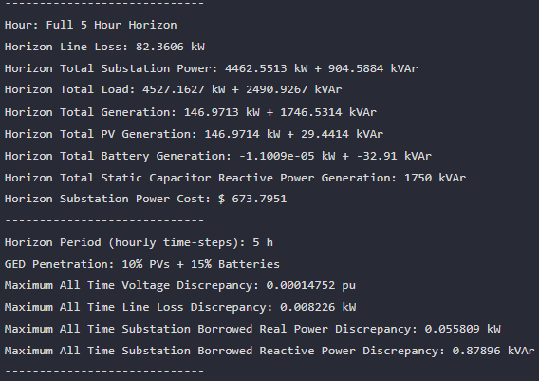
MPDOPF Verified for $T=5, PV=10\%, Batt=15\%$
strLoadShapeCost = 'New Loadshape.LoadShapeCost npts =5 interval = 1 mult = [0.048204 0.048204 0.30181 0.30181 0.048204]'
$P_{Subs}^{t}$
$P_{SubsCost}^{t}$
OpenDSS Def Profiles
Line Losses
OpenDSS Powerflow Results
$$P_{Loss}^{t}$$
MPDOPF Simulation Results
Objective
$$P_{SubsPeak}$$
Timings
Discrepancies

Slide 20
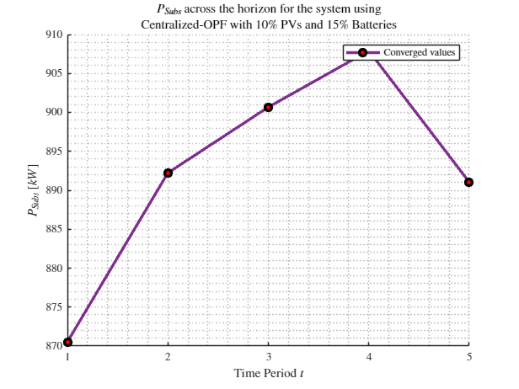

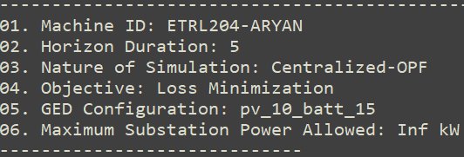
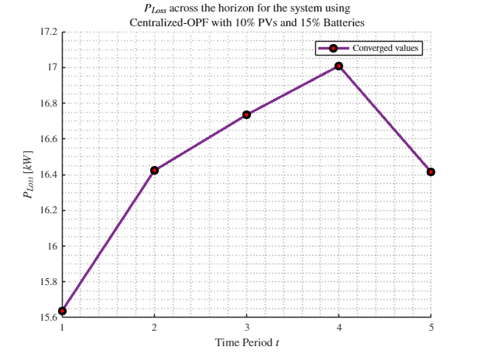
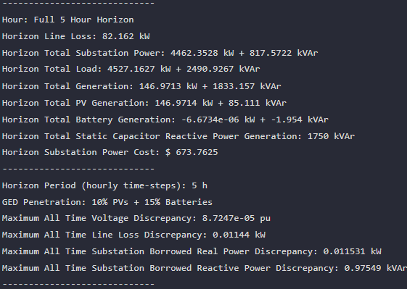


MPCOPF Verified for $T=5, PV=10\%, Batt=15\%$
strLoadShapeCost = 'New Loadshape.LoadShapeCost npts =5 interval = 1 mult = [0.048204 0.048204 0.30181 0.30181 0.048204]'
$P_{Subs}^{t}$
$P_{SubsCost}^{t}$
OpenDSS Def Profiles
Line Losses
OpenDSS Powerflow Results
$$P_{Loss}^{t}$$
MPDOPF Simulation Results
Objective
$$P_{SubsPeak}$$
Discrepancies
Timings

Slide 21

MPDOPF Verified for $T=5, PV=10\%, Batt=15\%$
strLoadShapeCost = 'New Loadshape.LoadShapeCost npts =5 interval = 1 mult = [0.048204 0.048204 0.30181 0.30181 0.048204]'
OpenDSS Def Profiles
Line Losses

Slide 22

MPCOPF Verified for $T=5, PV=10\%, Batt=15\%$
strLoadShapeCost = 'New Loadshape.LoadShapeCost npts =5 interval = 1 mult = [0.048204 0.048204 0.30181 0.30181 0.048204]'
OpenDSS Def Profiles
Line Losses

Slide 23
MPDOPF Verified for $T=5, PV=10\%, Batt=15\%$
strLoadShapeCost = 'New Loadshape.LoadShapeCost npts =5 interval = 1 mult = [0.048204 0.048204 0.30181 0.30181 0.048204]'
$P_{Subs}^{t}$
$P_{SubsCost}^{t}$
OpenDSS Def Profiles
Line Losses + Peak Shave
OpenDSS Powerflow Results
$$P_{Loss}^{t}$$
MPDOPF Simulation Results
Objective
$$P_{SubsPeak}$$
Timings
Discrepancies

Slide 24
MPCOPF Verified for $T=5, PV=10\%, Batt=15\%$
strLoadShapeCost = 'New Loadshape.LoadShapeCost npts =5 interval = 1 mult = [0.048204 0.048204 0.30181 0.30181 0.048204]'
$P_{Subs}^{t}$
$P_{SubsCost}^{t}$
OpenDSS Def Profiles
Line Losses + Peak Shave
OpenDSS Powerflow Results
$$P_{Loss}^{t}$$
MPDOPF Simulation Results
Objective
$$P_{SubsPeak}$$
Timings
Discrepancies

Slide 25
MPDOPF Verified for $T=5, PV=10\%, Batt=15\%$
strLoadShapeCost = 'New Loadshape.LoadShapeCost npts =5 interval = 1 mult = [0.048204 0.048204 0.30181 0.30181 0.048204]'
OpenDSS Def Profiles
Line Losses + Peak Shave

Slide 26
MPCOPF Verified for $T=5, PV=10\%, Batt=15\%$
strLoadShapeCost = 'New Loadshape.LoadShapeCost npts =5 interval = 1 mult = [0.048204 0.048204 0.30181 0.30181 0.048204]'
OpenDSS Def Profiles
Line Losses + Peak Shave

Slide 27






MPDOPF Verified for $T=5, PV=10\%, Batt=15\%$
strLoadShapeCost = 'New Loadshape.LoadShapeCost npts =5 interval = 1 mult = [0.048204 0.048204 0.30181 0.30181 0.048204]'
$P_{Subs}^{t}$
$P_{SubsCost}^{t}$
OpenDSS Def Profiles
Gen Cost
OpenDSS Powerflow Results
$$P_{Loss}^{t}$$
MPDOPF Simulation Results
Objective
$$P_{SubsPeak}$$
Timings
Discrepancies

Slide 28






MPCOPF Verified for $T=5, PV=10\%, Batt=15\%$
strLoadShapeCost = 'New Loadshape.LoadShapeCost npts =5 interval = 1 mult = [0.048204 0.048204 0.30181 0.30181 0.048204]'
$P_{Subs}^{t}$
$P_{SubsCost}^{t}$
OpenDSS Def Profiles
Gen Cost
OpenDSS Powerflow Results
$$P_{Loss}^{t}$$
MPDOPF Simulation Results
Objective
$$P_{SubsPeak}$$
Timings
Discrepancies

Slide 29




MPDOPF Verified for $T=5, PV=10\%, Batt=15\%$
strLoadShapeCost = 'New Loadshape.LoadShapeCost npts =5 interval = 1 mult = [0.048204 0.048204 0.30181 0.30181 0.048204]'
OpenDSS Def Profiles
Gen Cost

Slide 30




MPCOPF Verified for $T=5, PV=10\%, Batt=15\%$
strLoadShapeCost = 'New Loadshape.LoadShapeCost npts =5 interval = 1 mult = [0.048204 0.048204 0.30181 0.30181 0.048204]'
OpenDSS Def Profiles
Gen Cost

Slide 31






MPDOPF Verified for $T=5, PV=10\%, Batt=15\%$
strLoadShapeCost = 'New Loadshape.LoadShapeCost npts =5 interval = 1 mult = [0.048204 0.048204 0.30181 0.30181 0.048204]'
$P_{Subs}^{t}$
$P_{SubsCost}^{t}$
OpenDSS Def Profiles
Gen Cost + Peak Shave
OpenDSS Powerflow Results
$$P_{Loss}^{t}$$
MPDOPF Simulation Results
Timings
Discrepancies

Slide 32






MPCOPF Verified for $T=5, PV=10\%, Batt=15\%$
strLoadShapeCost = 'New Loadshape.LoadShapeCost npts =5 interval = 1 mult = [0.048204 0.048204 0.30181 0.30181 0.048204]'
$P_{Subs}^{t}$
$P_{SubsCost}^{t}$
OpenDSS Def Profiles
Gen Cost + Peak Shave
OpenDSS Powerflow Results
$$P_{Loss}^{t}$$
MPDOPF Simulation Results
Discrepancies
Timings

Slide 33




MPDOPF Verified for $T=5, PV=10\%, Batt=15\%$
strLoadShapeCost = 'New Loadshape.LoadShapeCost npts =5 interval = 1 mult = [0.048204 0.048204 0.30181 0.30181 0.048204]'
OpenDSS Def Profiles
Gen Cost + Peak Shave

Slide 34




MPCOPF Verified for $T=5, PV=10\%, Batt=15\%$
strLoadShapeCost = 'New Loadshape.LoadShapeCost npts =5 interval = 1 mult = [0.048204 0.048204 0.30181 0.30181 0.048204]'
OpenDSS Def Profiles
Gen Cost + Peak Shave

Slide 35







MPDOPF Verified for $T=12, PV=10\%, Batt=15\%$
$P_{Subs}^{t}$
$P_{SubsCost}^{t}$
OpenDSS Def Profiles
Gen Cost + Peak Shave
OpenDSS Powerflow Results
$$P_{Loss}^{t}$$
MPDOPF Simulation Results
Objective
$$P_{SubsPeak}$$
Timings
Discrepancies

Slide 36

MPCOPF Verified for $T=12, PV=10\%, Batt=15\%$
$P_{Subs}^{t}$
$P_{SubsCost}^{t}$
OpenDSS Def Profiles
Gen Cost + Peak Shave
OpenDSS Powerflow Results
$$P_{Loss}^{t}$$
MPDOPF Simulation Results
Timings
Discrepancies

Slide 37





MPDOPF Verified for $T=12, PV=10\%, Batt=15\%$
OpenDSS Def Profiles
Gen Cost + Peak Shave

Slide 38

MPCOPF Verified for $T=12, PV=10\%, Batt=15\%$
OpenDSS Def Profiles
Gen Cost + Peak Shave

Slide 39
MPDOPF Verified for $T=3, PV=10\%, Batt=15\%$
strLoadShape = 'New Loadshape.LoadShape npts =3 interval = 1 mult = [0.777 0.787 0.796]'
strLoadShapePV = 'New Loadshape.LoadShapePV npts =3 interval = 1 mult = [0.8 0.9 1]'
$P_{Subs}^{t}$
$P_{SubsCost}^{t}$
OpenDSS Def Profiles
Gen Cost + Peak Shave
OpenDSS Powerflow Results
$$P_{Loss}^{t}$$
MPDOPF Simulation Results
Timings
Discrepancies

Slide 40
MPCOPF Verified for $T=3, PV=10\%, Batt=15\%$
$P_{Subs}^{t}$
$P_{SubsCost}^{t}$
OpenDSS Def Profiles
Gen Cost + Peak Shave
OpenDSS Powerflow Results
$$P_{Loss}^{t}$$
MPDOPF Simulation Results
Timings
Discrepancies

Slide 41
MPDOPF Verified for $T=3, PV=10\%, Batt=15\%$
OpenDSS Def Profiles
Gen Cost + Peak Shave

Slide 42
MPCOPF Verified for $T=3, PV=10\%, Batt=15\%$
OpenDSS Def Profiles
Gen Cost + Peak Shave

Slide 43





MPDOPF Verified for $T=2, PV=10\%, Batt=15\%$
strLoadShape = 'New Loadshape.LoadShape npts =2 interval = 1 mult = [1 0.7]'
strLoadShapePV = 'New Loadshape.LoadShapePV npts =2 interval = 1 mult = [1.4 0.8]'
MPDOPF Simulation Results
Alternative Profiles
OpenDSS Powerflow Results

Slide 44





MPCOPF Verified for $T=2, PV=10\%, Batt=15\%$
strLoadShape = 'New Loadshape.LoadShape npts =2 interval = 1 mult = [1 0.7]'
strLoadShapePV = 'New Loadshape.LoadShapePV npts =2 interval = 1 mult = [1.4 0.8]'
MPCOPF Simulation Results
Alternative Profiles
OpenDSS Powerflow Results

Slide 45





MPDOPF Verified for $T=2, PV=10\%, Batt=15\%$
strLoadShape = 'New Loadshape.LoadShape npts =2 interval = 1 mult = [1 0.7]'
strLoadShapePV = 'New Loadshape.LoadShapePV npts =2 interval = 1 mult = [1.4 0.8]'
Alternative Profiles

Slide 46




MPCOPF Verified for $T=2, PV=10\%, Batt=15\%$
strLoadShape = 'New Loadshape.LoadShape npts =2 interval = 1 mult = [1 0.7]'
strLoadShapePV = 'New Loadshape.LoadShapePV npts =2 interval = 1 mult = [1.4 0.8]'
Alternative Profiles

Slide 47




Boundary Complex Powers
strLoadShape = 'New Loadshape.LoadShape npts =2 interval = 1 mult = [1 0.7]'
MPDOPF Verified for $T=2, PV=10\%, Batt=15\%$
strLoadShapePV = 'New Loadshape.LoadShapePV npts =2 interval = 1 mult = [1.4 0.8]'
Alternative Profiles

Slide 48



Boundary Voltages
strLoadShape = 'New Loadshape.LoadShape npts =2 interval = 1 mult = [1 0.7]'
MPDOPF Verified for $T=2, PV=10\%, Batt=15\%$
strLoadShapePV = 'New Loadshape.LoadShapePV npts =2 interval = 1 mult = [1.4 0.8]'
Alternative Profiles

Slide 49



MPDOPF Verified for $T=3, PV=10\%, Batt=15\%$
strLoadShape = 'New Loadshape.LoadShape npts =3 interval = 1 mult = [0.777 0.787 0.796]'
strLoadShapePV = 'New Loadshape.LoadShapePV npts =3 interval = 1 mult = [0.8 0.9 1]'
MPDOPF Simulation Results
OpenDSS Powerflow Results
OpenDSS Def Profiles

Slide 50
MPCOPF Verified for $T=3, PV=10\%, Batt=15\%$
strLoadShape = 'New Loadshape.LoadShape npts =3 interval = 1 mult = [0.777 0.787 0.796]'
strLoadShapePV = 'New Loadshape.LoadShapePV npts =3 interval = 1 mult = [0.8 0.9 1]'
MPDOPF Simulation Results
OpenDSS Powerflow Results
OpenDSS Def Profiles

Slide 51



MPDOPF Verified for $T=3, PV=10\%, Batt=15\%$
strLoadShape = 'New Loadshape.LoadShape npts =3 interval = 1 mult = [0.777 0.787 0.796]'
strLoadShapePV = 'New Loadshape.LoadShapePV npts =3 interval = 1 mult = [0.8 0.9 1]'
OpenDSS Def Profiles

Slide 52
MPCOPF Verified for $T=3, PV=10\%, Batt=15\%$
strLoadShape = 'New Loadshape.LoadShape npts =3 interval = 1 mult = [0.777 0.787 0.796]'
strLoadShapePV = 'New Loadshape.LoadShapePV npts =3 interval = 1 mult = [0.8 0.9 1]'
OpenDSS Def Profiles

Slide 53




Boundary Complex Powers
strLoadShape = 'New Loadshape.LoadShape npts =3 interval = 1 mult = [0.777 0.787 0.796]'
MPDOPF Verified for $T=3, PV=10\%, Batt=15\%$
strLoadShapePV = 'New Loadshape.LoadShapePV npts =3 interval = 1 mult = [0.8 0.9 1]'
OpenDSS Def Profiles

Slide 54



Boundary Voltages
strLoadShape = 'New Loadshape.LoadShape npts =3 interval = 1 mult = [0.777 0.787 0.796]'
MPDOPF Verified for $T=3, PV=10\%, Batt=15\%$
strLoadShapePV = 'New Loadshape.LoadShapePV npts =3 interval = 1 mult = [0.8 0.9 1]'
OpenDSS Def Profiles

Slide 55




MPDOPF Verified for $T=3, PV=10\%, Batt=15\%$
strLoadShape = 'New Loadshape.LoadShape npts =3 interval = 1 mult = [0.7 1 0.7]'
strLoadShapePV = 'New Loadshape.LoadShapePV npts =3 interval = 1 mult = [0.8 1 0.8]'
MPDOPF Simulation Results
Alternative Profiles
OpenDSS Powerflow Results

Slide 56





MPCOPF Verified for $T=3, PV=10\%, Batt=15\%$
strLoadShape = 'New Loadshape.LoadShape npts =3 interval = 1 mult = [0.7 1 0.7]'
strLoadShapePV = 'New Loadshape.LoadShapePV npts =3 interval = 1 mult = [0.8 1 0.8]'
MPCOPF Simulation Results
Alternative Profiles
OpenDSS Powerflow Results

Slide 57




MPDOPF Verified for $T=3, PV=10\%, Batt=15\%$
strLoadShape = 'New Loadshape.LoadShape npts =3 interval = 1 mult = [0.7 1 0.7]'
strLoadShapePV = 'New Loadshape.LoadShapePV npts =3 interval = 1 mult = [0.8 1 0.8]'
Alternative Profiles

Slide 58



MPCOPF Verified for $T=3, PV=10\%, Batt=15\%$
strLoadShape = 'New Loadshape.LoadShape npts =3 interval = 1 mult = [0.7 1 0.7]'
strLoadShapePV = 'New Loadshape.LoadShapePV npts =3 interval = 1 mult = [0.8 1 0.8]'
Alternative Profiles

Slide 59



Boundary Complex Powers
strLoadShape = 'New Loadshape.LoadShape npts =3 interval = 1 mult = [0.7 1 0.7]'
MPDOPF Verified for $T=3, PV=10\%, Batt=15\%$
strLoadShapePV = 'New Loadshape.LoadShapePV npts =3 interval = 1 mult = [0.8 1 0.8]'
Alternative Profiles

Slide 60



Boundary Voltages
strLoadShape = 'New Loadshape.LoadShape npts =3 interval = 1 mult = [0.7 1 0.7]'
MPDOPF Verified for $T=3, PV=10\%, Batt=15\%$
strLoadShapePV = 'New Loadshape.LoadShapePV npts =3 interval = 1 mult = [0.8 1 0.8]'
Alternative Profiles

Slide 61





MPDOPF Verified for $T=5, PV=10\%, Batt=15\%$
strLoadShape = 'New Loadshape.LoadShape npts =5 interval = 1 mult = [0.75 0.777 0.787 0.796 0.782]'
strLoadShapePV = 'New Loadshape.LoadShapePV npts =5 interval = 1 mult = [0.5 0.8 0.9 1 1]'
MPDOPF Simulation Results
OpenDSS Powerflow Results

Slide 62





MPCOPF Verified for $T=5, PV=10\%, Batt=15\%$
strLoadShape = 'New Loadshape.LoadShape npts =5 interval = 1 mult = [0.75 0.777 0.787 0.796 0.782]'
strLoadShapePV = 'New Loadshape.LoadShapePV npts =5 interval = 1 mult = [0.5 0.8 0.9 1 1]'
MPCOPF Simulation Results
OpenDSS Powerflow Results

Slide 63




Boundary Complex Powers
MPDOPF Verified for $T=5, PV=10\%, Batt=15\%$

Slide 64



Boundary Voltages
MPDOPF Verified for $T=5, PV=10\%, Batt=15\%$

Slide 65




MPDOPF Verified for $T=5, PV=10\%, Batt=15\%$
strLoadShape = 'New Loadshape.LoadShape npts =5 interval = 1 mult = [0.7 0.85 1 0.85 0.7]'
strLoadShapePV = 'New Loadshape.LoadShapePV npts =5 interval = 1 mult = [1 1.2828 1.4 1.1 0.8]'
MPDOPF Simulation Results
Alternative Profiles
OpenDSS Powerflow Results

Slide 66




MPCOPF Verified for $T=5, PV=10\%, Batt=15\%$
strLoadShape = 'New Loadshape.LoadShape npts =5 interval = 1 mult = [0.7 0.85 1 0.85 0.7]'
strLoadShapePV = 'New Loadshape.LoadShapePV npts =5 interval = 1 mult = [1 1.2828 1.4 1.1 0.8]'
MPCOPF Simulation Results
Alternative Profiles
OpenDSS Powerflow Results

Slide 67




MPDOPF Verified for $T=5, PV=10\%, Batt=15\%$
strLoadShape = 'New Loadshape.LoadShape npts =5 interval = 1 mult = [0.7 0.85 1 0.85 0.7]'
strLoadShapePV = 'New Loadshape.LoadShapePV npts =5 interval = 1 mult = [1 1.2828 1.4 1.1 0.8]'
Alternative Profiles

Slide 68




MPCOPF Verified for $T=5, PV=10\%, Batt=15\%$
strLoadShape = 'New Loadshape.LoadShape npts =5 interval = 1 mult = [0.7 0.85 1 0.85 0.7]'
strLoadShapePV = 'New Loadshape.LoadShapePV npts =5 interval = 1 mult = [1 1.2828 1.4 1.1 0.8]'
Alternative Profiles

Slide 69



Boundary Complex Powers
strLoadShape = 'New Loadshape.LoadShape npts =5 interval = 1 mult = [0.7 0.85 1 0.85 0.7]'
MPDOPF Verified for $T=5, PV=10\%, Batt=15\%$
strLoadShapePV = 'New Loadshape.LoadShapePV npts =5 interval = 1 mult = [1 1.2828 1.4 1.1 0.8]'
Alternative Profiles

Slide 70



Boundary Voltages
strLoadShape = 'New Loadshape.LoadShape npts =5 interval = 1 mult = [0.7 0.85 1 0.85 0.7]'
MPDOPF Verified for $T=5, PV=10\%, Batt=15\%$
strLoadShapePV = 'New Loadshape.LoadShapePV npts =5 interval = 1 mult = [1 1.2828 1.4 1.1 0.8]'
Alternative Profiles

Slide 71


MPDOPF Verified for $T=8, PV=10\%, Batt=15\%$
strLoadShape = 'New Loadshape.LoadShape npts =8 interval = 1 mult = [0.705 0.75 0.777 0.787 0.796 0.782 0.783 0.789]'
strLoadShapePV = 'New Loadshape.LoadShapePV npts =8 interval = 1 mult = [0.3 0.5 0.8 0.9 1 1 0.99 0.9]'
MPDOPF Simulation Results
OpenDSS Powerflow Results

Slide 72





MPCOPF Verified for $T=8, PV=10\%, Batt=15\%$
strLoadShape = 'New Loadshape.LoadShape npts =8 interval = 1 mult = [0.705 0.75 0.777 0.787 0.796 0.782 0.783 0.789]'
strLoadShapePV = 'New Loadshape.LoadShapePV npts =8 interval = 1 mult = [0.3 0.5 0.8 0.9 1 1 0.99 0.9]'
MPCOPF Simulation Results
OpenDSS Powerflow Results

Slide 73

MPDOPF Verified for $T=8, PV=10\%, Batt=15\%$
strLoadShape = 'New Loadshape.LoadShape npts =8 interval = 1 mult = [0.705 0.75 0.777 0.787 0.796 0.782 0.783 0.789]'
1, 5, 7, 8 in COPF values
strLoadShapePV = 'New Loadshape.LoadShapePV npts =8 interval = 1 mult = [0.3 0.5 0.8 0.9 1 1 0.99 0.9]'

Slide 74





MPCOPF Verified for $T=8, PV=10\%, Batt=15\%$
strLoadShape = 'New Loadshape.LoadShape npts =8 interval = 1 mult = [0.705 0.75 0.777 0.787 0.796 0.782 0.783 0.789]'
strLoadShapePV = 'New Loadshape.LoadShapePV npts =8 interval = 1 mult = [0.3 0.5 0.8 0.9 1 1 0.99 0.9]'

Slide 75




Boundary Complex Powers
strLoadShape = 'New Loadshape.LoadShape npts =8 interval = 1 mult = [0.705 0.75 0.777 0.787 0.796 0.782 0.783 0.789]'
MPDOPF Verified for $T=8, PV=10\%, Batt=15\%$
strLoadShapePV = 'New Loadshape.LoadShapePV npts =8 interval = 1 mult = [0.3 0.5 0.8 0.9 1 1 0.99 0.9]'

Slide 76



Boundary Voltages
strLoadShape = 'New Loadshape.LoadShape npts =8 interval = 1 mult = [0.705 0.75 0.777 0.787 0.796 0.782 0.783 0.789]'
MPDOPF Verified for $T=8, PV=10\%, Batt=15\%$
strLoadShapePV = 'New Loadshape.LoadShapePV npts =8 interval = 1 mult = [0.3 0.5 0.8 0.9 1 1 0.99 0.9]'

Slide 77





MPDOPF Verified for $T=9, PV=10\%, Batt=15\%$
strLoadShape = 'New Loadshape.LoadShape npts =9 interval = 1 mult = [0.668 0.705 0.75 0.777 0.787 0.796 0.782 0.783 0.789]'
strLoadShapePV = 'New Loadshape.LoadShapePV npts =9 interval = 1 mult = [0.2 0.3 0.5 0.8 0.9 1 1 0.99 0.9]'
MPDOPF Simulation Results
OpenDSS Powerflow Results

Slide 78





MPCOPF Verified for $T=9, PV=10\%, Batt=15\%$
strLoadShape = 'New Loadshape.LoadShape npts =9 interval = 1 mult = [0.668 0.705 0.75 0.777 0.787 0.796 0.782 0.783 0.789]'
strLoadShapePV = 'New Loadshape.LoadShapePV npts =9 interval = 1 mult = [0.2 0.3 0.5 0.8 0.9 1 1 0.99 0.9]'
MPCOPF Simulation Results
OpenDSS Powerflow Results

Slide 79








MPDOPF Verified for $T=9, PV=10\%, Batt=15\%$
strLoadShape = 'New Loadshape.LoadShape npts =9 interval = 1 mult = [0.668 0.705 0.75 0.777 0.787 0.796 0.782 0.783 0.789]'
strLoadShapePV = 'New Loadshape.LoadShapePV npts =9 interval = 1 mult = [0.2 0.3 0.5 0.8 0.9 1 1 0.99 0.9]'

Slide 80








MPCOPF Verified for $T=9, PV=10\%, Batt=15\%$
strLoadShape = 'New Loadshape.LoadShape npts =9 interval = 1 mult = [0.668 0.705 0.75 0.777 0.787 0.796 0.782 0.783 0.789]'
strLoadShapePV = 'New Loadshape.LoadShapePV npts =9 interval = 1 mult = [0.2 0.3 0.5 0.8 0.9 1 1 0.99 0.9]'

Slide 81




Boundary Complex Powers
strLoadShape = 'New Loadshape.LoadShape npts =9 interval = 1 mult = [0.668 0.705 0.75 0.777 0.787 0.796 0.782 0.783 0.789]'
MPDOPF Verified for $T=9, PV=10\%, Batt=15\%$
strLoadShapePV = 'New Loadshape.LoadShapePV npts =9 interval = 1 mult = [0.2 0.3 0.5 0.8 0.9 1 1 0.99 0.9]'

Slide 82



Boundary Voltages
strLoadShape = 'New Loadshape.LoadShape npts =9 interval = 1 mult = [0.668 0.705 0.75 0.777 0.787 0.796 0.782 0.783 0.789]'
MPDOPF Verified for $T=9, PV=10\%, Batt=15\%$
strLoadShapePV = 'New Loadshape.LoadShapePV npts =9 interval = 1 mult = [0.2 0.3 0.5 0.8 0.9 1 1 0.99 0.9]'

Slide 83





MPDOPF Verified for $T=10, PV=10\%, Batt=15\%$
strLoadShape = 'New Loadshape.LoadShape npts =10 interval = 1 mult = [0.668 0.705 0.75 0.777 0.787 0.796 0.782 0.783 0.789 0.826]'
strLoadShapePV = 'New Loadshape.LoadShapePV npts =10 interval = 1 mult = [0.2 0.3 0.5 0.8 0.9 1 1 0.99 0.9 0.7]'
MPDOPF Simulation Results
OpenDSS Powerflow Results

Slide 84





MPCOPF Verified for $T=10, PV=10\%, Batt=15\%$
strLoadShape = 'New Loadshape.LoadShape npts =10 interval = 1 mult = [0.668 0.705 0.75 0.777 0.787 0.796 0.782 0.783 0.789 0.826]'
strLoadShapePV = 'New Loadshape.LoadShapePV npts =10 interval = 1 mult = [0.2 0.3 0.5 0.8 0.9 1 1 0.99 0.9 0.7]'
MPCOPF Simulation Results
OpenDSS Powerflow Results

Slide 85





MPDOPF Verified for $T=10, PV=10\%, Batt=15\%$
strLoadShape = 'New Loadshape.LoadShape npts =10 interval = 1 mult = [0.668 0.705 0.75 0.777 0.787 0.796 0.782 0.783 0.789 0.826]'
strLoadShapePV = 'New Loadshape.LoadShapePV npts =10 interval = 1 mult = [0.2 0.3 0.5 0.8 0.9 1 1 0.99 0.9 0.7]'

Slide 86





MPCOPF Verified for $T=10, PV=10\%, Batt=15\%$
strLoadShape = 'New Loadshape.LoadShape npts =10 interval = 1 mult = [0.668 0.705 0.75 0.777 0.787 0.796 0.782 0.783 0.789 0.826]'
strLoadShapePV = 'New Loadshape.LoadShapePV npts =10 interval = 1 mult = [0.2 0.3 0.5 0.8 0.9 1 1 0.99 0.9 0.7]'

Slide 87




Boundary Complex Powers
MPDOPF Verified for $T=10, PV=10\%, Batt=15\%$

Slide 88



Boundary Voltages
MPDOPF Verified for $T=10, PV=10\%, Batt=15\%$

Slide 89





MPDOPF Verified for $T=11, PV=10\%, Batt=15\%$
strLoadShape = 'New Loadshape.LoadShape npts =11 interval = 1 mult = [0.644 0.668 0.705 0.75 0.777 0.787 0.796 0.782 0.783 0.789 0.826]'
strLoadShapePV = 'New Loadshape.LoadShapePV npts =11 interval = 1 mult = [0.1 0.2 0.3 0.5 0.8 0.9 1 1 0.99 0.9 0.7]'
MPDOPF Simulation Results
OpenDSS Powerflow Results
OpenDSS Def Profiles

Slide 90

MPCOPF Verified for $T=11, PV=10\%, Batt=15\%$
strLoadShape = 'New Loadshape.LoadShape npts =11 interval = 1 mult = [0.644 0.668 0.705 0.75 0.777 0.787 0.796 0.782 0.783 0.789 0.826]'
strLoadShapePV = 'New Loadshape.LoadShapePV npts =11 interval = 1 mult = [0.1 0.2 0.3 0.5 0.8 0.9 1 1 0.99 0.9 0.7]'
MPDOPF Simulation Results
OpenDSS Powerflow Results
OpenDSS Def Profiles

Slide 91





MPDOPF Verified for $T=11, PV=10\%, Batt=15\%$
strLoadShape = 'New Loadshape.LoadShape npts =11 interval = 1 mult = [0.644 0.668 0.705 0.75 0.777 0.787 0.796 0.782 0.783 0.789 0.826]'
strLoadShapePV = 'New Loadshape.LoadShapePV npts =11 interval = 1 mult = [0.1 0.2 0.3 0.5 0.8 0.9 1 1 0.99 0.9 0.7]'
OpenDSS Def Profiles

Slide 92

MPCOPF Verified for $T=11, PV=10\%, Batt=15\%$
strLoadShape = 'New Loadshape.LoadShape npts =11 interval = 1 mult = [0.644 0.668 0.705 0.75 0.777 0.787 0.796 0.782 0.783 0.789 0.826]'
strLoadShapePV = 'New Loadshape.LoadShapePV npts =11 interval = 1 mult = [0.1 0.2 0.3 0.5 0.8 0.9 1 1 0.99 0.9 0.7]'
OpenDSS Def Profiles

Slide 93




Boundary Complex Powers
strLoadShape = 'New Loadshape.LoadShape npts =11 interval = 1 mult = [0.644 0.668 0.705 0.75 0.777 0.787 0.796 0.782 0.783 0.789 0.826]'
MPDOPF Verified for $T=11, PV=10\%, Batt=15\%$
strLoadShapePV = 'New Loadshape.LoadShapePV npts =11 interval = 1 mult = [0.1 0.2 0.3 0.5 0.8 0.9 1 1 0.99 0.9 0.7]'
OpenDSS Def Profiles

Slide 94



Boundary Voltages
strLoadShape = 'New Loadshape.LoadShape npts =11 interval = 1 mult = [0.644 0.668 0.705 0.75 0.777 0.787 0.796 0.782 0.783 0.789 0.826]'
MPDOPF Verified for $T=11, PV=10\%, Batt=15\%$
strLoadShapePV = 'New Loadshape.LoadShapePV npts =11 interval = 1 mult = [0.1 0.2 0.3 0.5 0.8 0.9 1 1 0.99 0.9 0.7]'
OpenDSS Def Profiles

Slide 95




MPDOPF Verified for $T=12, PV=10\%, Batt=15\%$
strLoadShape = 'New Loadshape.LoadShape npts =12 interval = 1 mult = [0.644 0.668 0.705 0.75 0.777 0.787 0.796 0.782 0.783 0.789 0.826 0.855]'
strLoadShapePV = 'New Loadshape.LoadShapePV npts =12 interval = 1 mult = [0.1 0.2 0.3 0.5 0.8 0.9 1 1 0.99 0.9 0.7 0.4]'
MPDOPF Simulation Results
OpenDSS Powerflow Results
OpenDSS Def Profiles

Slide 96




MPCOPF Verified for $T=12, PV=10\%, Batt=15\%$
strLoadShape = 'New Loadshape.LoadShape npts =12 interval = 1 mult = [0.644 0.668 0.705 0.75 0.777 0.787 0.796 0.782 0.783 0.789 0.826 0.855]'
strLoadShapePV = 'New Loadshape.LoadShapePV npts =12 interval = 1 mult = [0.1 0.2 0.3 0.5 0.8 0.9 1 1 0.99 0.9 0.7 0.4]'
MPDOPF Simulation Results
OpenDSS Powerflow Results
OpenDSS Def Profiles

Slide 97




MPDOPF Verified for $T=12, PV=10\%, Batt=15\%$
strLoadShape = 'New Loadshape.LoadShape npts =12 interval = 1 mult = [0.644 0.668 0.705 0.75 0.777 0.787 0.796 0.782 0.783 0.789 0.826 0.855]'
strLoadShapePV = 'New Loadshape.LoadShapePV npts =12 interval = 1 mult = [0.1 0.2 0.3 0.5 0.8 0.9 1 1 0.99 0.9 0.7 0.4]'
OpenDSS Def Profiles

Slide 98
MPCOPF Verified for $T=12, PV=10\%, Batt=15\%$
strLoadShape = 'New Loadshape.LoadShape npts =12 interval = 1 mult = [0.644 0.668 0.705 0.75 0.777 0.787 0.796 0.782 0.783 0.789 0.826 0.855]'
strLoadShapePV = 'New Loadshape.LoadShapePV npts =12 interval = 1 mult = [0.1 0.2 0.3 0.5 0.8 0.9 1 1 0.99 0.9 0.7 0.4]'
OpenDSS Def Profiles

Slide 99




Boundary Complex Powers
strLoadShape = 'New Loadshape.LoadShape npts =12 interval = 1 mult = [0.644 0.668 0.705 0.75 0.777 0.787 0.796 0.782 0.783 0.789 0.826 0.855]'
MPDOPF Verified for $T=12, PV=10\%, Batt=15\%$
strLoadShapePV = 'New Loadshape.LoadShapePV npts =12 interval = 1 mult = [0.1 0.2 0.3 0.5 0.8 0.9 1 1 0.99 0.9 0.7 0.4]'
OpenDSS Def Profiles

Slide 100



Boundary Voltages
strLoadShape = 'New Loadshape.LoadShape npts =12 interval = 1 mult = [0.644 0.668 0.705 0.75 0.777 0.787 0.796 0.782 0.783 0.789 0.826 0.855]'
MPDOPF Verified for $T=12, PV=10\%, Batt=15\%$
strLoadShapePV = 'New Loadshape.LoadShapePV npts =12 interval = 1 mult = [0.1 0.2 0.3 0.5 0.8 0.9 1 1 0.99 0.9 0.7 0.4]'
OpenDSS Def Profiles

Slide 101





MPDOPF Verified for $T=16, PV=10\%, Batt=15\%$
strLoadShape = 'New Loadshape.LoadShape npts =16 interval = 1 mult = [0.598 0.613 0.644 0.668 0.705 0.75 0.777 0.787 0.796 0.782 0.783 0.789 0.826 0.855 0.95 1]'
strLoadShapePV = 'New Loadshape.LoadShapePV npts =16 interval = 1 mult = [0 0 0.1 0.2 0.3 0.5 0.8 0.9 1 1 0.99 0.9 0.7 0.4 0.1 0]'
MPDOPF Simulation Results
OpenDSS Powerflow Results
OpenDSS Def Profiles

Slide 102





MPDOPF Verified for $T=16, PV=10\%, Batt=15\%$
strLoadShape = 'New Loadshape.LoadShape npts =16 interval = 1 mult = [0.598 0.613 0.644 0.668 0.705 0.75 0.777 0.787 0.796 0.782 0.783 0.789 0.826 0.855 0.95 1]'
strLoadShapePV = 'New Loadshape.LoadShapePV npts =16 interval = 1 mult = [0 0 0.1 0.2 0.3 0.5 0.8 0.9 1 1 0.99 0.9 0.7 0.4 0.1 0]'
OpenDSS Def Profiles

Slide 103




Boundary Complex Powers
strLoadShape = 'New Loadshape.LoadShape npts =16 interval = 1 mult = [0.598 0.613 0.644 0.668 0.705 0.75 0.777 0.787 0.796 0.782 0.783 0.789 0.826 0.855 0.95 1]'
MPDOPF Verified for $T=16, PV=10\%, Batt=15\%$
strLoadShapePV = 'New Loadshape.LoadShapePV npts =16 interval = 1 mult = [0 0 0.1 0.2 0.3 0.5 0.8 0.9 1 1 0.99 0.9 0.7 0.4 0.1 0]'
OpenDSS Def Profiles

Slide 104



Boundary Voltages
strLoadShape = 'New Loadshape.LoadShape npts =16 interval = 1 mult = [0.598 0.613 0.644 0.668 0.705 0.75 0.777 0.787 0.796 0.782 0.783 0.789 0.826 0.855 0.95 1]'
MPDOPF Verified for $T=16, PV=10\%, Batt=15\%$
strLoadShapePV = 'New Loadshape.LoadShapePV npts =16 interval = 1 mult = [0 0 0.1 0.2 0.3 0.5 0.8 0.9 1 1 0.99 0.9 0.7 0.4 0.1 0]'
OpenDSS Def Profiles

Slide 105
MPDOPF Verified for $T=3, PV=10\%, Batt=15\%$
strLoadShape = 'New Loadshape.LoadShape npts =11 interval = 1 mult = [0.644 0.668 0.705 0.75 0.777 0.787 0.796 0.782 0.783 0.789 0.826]'
strLoadShapePV = 'New Loadshape.LoadShapePV npts =11 interval = 1 mult = [0.1 0.2 0.3 0.5 0.8 0.9 1 1 0.99 0.9 0.7]'
MPDOPF Simulation Results
OpenDSS Powerflow Results
OpenDSS Def Profiles

Slide 106
MPCOPF Verified for $T=3, PV=10\%, Batt=15\%$
MPDOPF Simulation Results
OpenDSS Powerflow Results
OpenDSS Def Profiles

Slide 107
MPDOPF Verified for $T=3, PV=10\%, Batt=15\%$
OpenDSS Def Profiles

Slide 108
MPCOPF Verified for $T=3, PV=10\%, Batt=15\%$
OpenDSS Def Profiles

Slide 109
Boundary Complex Powers
MPDOPF Verified for $T=3, PV=10\%, Batt=15\%$
OpenDSS Def Profiles

Slide 110
Boundary Voltages
MPDOPF Verified for $T=3, PV=10\%, Batt=15\%$
OpenDSS Def Profiles

Slide 111
MPDOPF Verified for $T=5, PV=10\%, Batt=15\%$
strLoadShape = 'New Loadshape.LoadShape npts =5 interval = 1 mult = [0.75 0.777 0.787 0.796 0.782]'
strLoadShapePV = 'New Loadshape.LoadShapePV npts =5 interval = 1 mult = [0.5 0.8 0.9 1 1]'
MPDOPF Simulation Results
OpenDSS Powerflow Results

Slide 112
MPCOPF Verified for $T=5, PV=10\%, Batt=15\%$
strLoadShape = 'New Loadshape.LoadShape npts =5 interval = 1 mult = [0.75 0.777 0.787 0.796 0.782]'
strLoadShapePV = 'New Loadshape.LoadShapePV npts =5 interval = 1 mult = [0.5 0.8 0.9 1 1]'
MPCOPF Simulation Results
OpenDSS Powerflow Results

Slide 113



MPDOPF Verified for $T=10, PV=10\%, Batt=15\%$
strLoadShape = 'New Loadshape.LoadShape npts =10 interval = 1 mult = [0.668 0.705 0.75 0.777 0.787 0.796 0.782 0.783 0.789 0.826]'
strLoadShapePV = 'New Loadshape.LoadShapePV npts =10 interval = 1 mult = [0.2 0.3 0.5 0.8 0.9 1 1 0.99 0.9 0.7]'

Slide 114

MPCOPF Verified for $T=10, PV=10\%, Batt=15\%$
strLoadShape = 'New Loadshape.LoadShape npts =10 interval = 1 mult = [0.668 0.705 0.75 0.777 0.787 0.796 0.782 0.783 0.789 0.826]'
strLoadShapePV = 'New Loadshape.LoadShapePV npts =10 interval = 1 mult = [0.2 0.3 0.5 0.8 0.9 1 1 0.99 0.9 0.7]'

Slide 115
Boundary Complex Powers
strLoadShape = 'New Loadshape.LoadShape npts =10 interval = 1 mult = [0.668 0.705 0.75 0.777 0.787 0.796 0.782 0.783 0.789 0.826]'
MPDOPF Verified for $T=5, PV=10\%, Batt=15\%$
strLoadShapePV = 'New Loadshape.LoadShapePV npts =10 interval = 1 mult = [0.2 0.3 0.5 0.8 0.9 1 1 0.99 0.9 0.7]'

Slide 116
Boundary Voltages
strLoadShape = 'New Loadshape.LoadShape npts =10 interval = 1 mult = [0.668 0.705 0.75 0.777 0.787 0.796 0.782 0.783 0.789 0.826]'
MPDOPF Verified for $T=5, PV=10\%, Batt=15\%$
strLoadShapePV = 'New Loadshape.LoadShapePV npts =10 interval = 1 mult = [0.2 0.3 0.5 0.8 0.9 1 1 0.99 0.9 0.7]'

Slide 117





MPDOPF Verified for $T=1, PV=10\%, Batt=0\%$
strLoadShape = 'New Loadshape.LoadShape npts =1 interval = 1 mult = [0.787]'
strLoadShapePV = 'New Loadshape.LoadShapePV npts =1 interval = 1 mult = [0.9]'
MPDOPF Simulation Results
OpenDSS Powerflow Results

Slide 118





MPCOPF Verified for $T=1, PV=10\%, Batt=0\%$
strLoadShape = 'New Loadshape.LoadShape npts =1 interval = 1 mult = [0.787]'
strLoadShapePV = 'New Loadshape.LoadShapePV npts =1 interval = 1 mult = [0.9]'
MPCOPF Simulation Results
OpenDSS Powerflow Results

Slide 119





MPDOPF Verified for $T=1, PV=10\%, Batt=15\%$
strLoadShape = 'New Loadshape.LoadShape npts =1 interval = 1 mult = [0.787]'
strLoadShapePV = 'New Loadshape.LoadShapePV npts =1 interval = 1 mult = [0.9]'
MPDOPF Simulation Results
OpenDSS Powerflow Results

Slide 120





MPCOPF Verified for $T=1, PV=10\%, Batt=15\%$
strLoadShape = 'New Loadshape.LoadShape npts =1 interval = 1 mult = [0.787]'
strLoadShapePV = 'New Loadshape.LoadShapePV npts =1 interval = 1 mult = [0.9]'
MPCOPF Simulation Results
OpenDSS Powerflow Results

Slide 121





MPDOPF Verified for $T=2, PV=10\%, Batt=15\%$
strLoadShape = 'New Loadshape.LoadShape npts =2 interval = 1 mult = [0.787 0.796]'
strLoadShapePV = 'New Loadshape.LoadShapePV npts =2 interval = 1 mult = [0.9 1]'
MPDOPF Simulation Results
OpenDSS Powerflow Results

Slide 122





MPCOPF Verified for $T=2, PV=10\%, Batt=15\%$
strLoadShape = 'New Loadshape.LoadShape npts =2 interval = 1 mult = [0.787 0.796]'
strLoadShapePV = 'New Loadshape.LoadShapePV npts =2 interval = 1 mult = [0.9 1]'
MPCOPF Simulation Results
OpenDSS Powerflow Results

Slide 123

MPDOPF Verified for $T=3, PV=10\%, Batt=15\%$
strLoadShape = 'New Loadshape.LoadShape npts =3 interval = 1 mult = [0.777 0.787 0.796]'
strLoadShapePV = 'New Loadshape.LoadShapePV npts =3 interval = 1 mult = [0.8 0.9 1]'
MPDOPF Simulation Results
OpenDSS Powerflow Results

Slide 124




MPCOPF Verified for $T=3, PV=10\%, Batt=15\%$
strLoadShape = 'New Loadshape.LoadShape npts =3 interval = 1 mult = [0.777 0.787 0.796]'
strLoadShapePV = 'New Loadshape.LoadShapePV npts =3 interval = 1 mult = [0.8 0.9 1]'
MPCOPF Simulation Results
OpenDSS Powerflow Results

Slide 125




MPDOPF Verified for $T=5, PV=10\%, Batt=15\%$
strLoadShape = 'New Loadshape.LoadShape npts =5 interval = 1 mult = [0.75 0.777 0.787 0.796 0.782]'
strLoadShapePV = 'New Loadshape.LoadShapePV npts =5 interval = 1 mult = [0.5 0.8 0.9 1 1]'
MPDOPF Simulation Results
OpenDSS Powerflow Results

Slide 126




MPCOPF Verified for $T=5, PV=10\%, Batt=15\%$
strLoadShape = 'New Loadshape.LoadShape npts =5 interval = 1 mult = [0.75 0.777 0.787 0.796 0.782]'
strLoadShapePV = 'New Loadshape.LoadShapePV npts =5 interval = 1 mult = [0.5 0.8 0.9 1 1]'
MPCOPF Simulation Results
OpenDSS Powerflow Results

Slide 127





MPDOPF Verified for $T=5, PV=10\%, Batt=15\%$
strLoadShape = 'New Loadshape.LoadShape npts =5 interval = 1 mult = [0.75 0.777 0.787 0.796 0.782]'
strLoadShapePV = 'New Loadshape.LoadShapePV npts =5 interval = 1 mult = [0.5 0.8 0.9 1 1]'

Slide 128





MPCOPF Verified for $T=5, PV=10\%, Batt=15\%$
strLoadShape = 'New Loadshape.LoadShape npts =5 interval = 1 mult = [0.75 0.777 0.787 0.796 0.782]'
strLoadShapePV = 'New Loadshape.LoadShapePV npts =5 interval = 1 mult = [0.5 0.8 0.9 1 1]'

Slide 129



Boundary Complex Powers
MPDOPF Verified for $T=5, PV=10\%, Batt=15\%$

Slide 130



Boundary Voltages
MPDOPF Verified for $T=5, PV=10\%, Batt=15\%$

Slide 131




MPDOPF Verified for $T=10, PV=10\%, Batt=15\%$
strLoadShape = 'New Loadshape.LoadShape npts =10 interval = 1 mult = [0.668 0.705 0.75 0.777 0.787 0.796 0.782 0.783 0.789 0.826]'
strLoadShapePV = 'New Loadshape.LoadShapePV npts =10 interval = 1 mult = [0.2 0.3 0.5 0.8 0.9 1 1 0.99 0.9 0.7]'
MPDOPF Simulation Results
OpenDSS Powerflow Results

Slide 132




MPCOPF Verified for $T=10, PV=10\%, Batt=15\%$
strLoadShape = 'New Loadshape.LoadShape npts =10 interval = 1 mult = [0.668 0.705 0.75 0.777 0.787 0.796 0.782 0.783 0.789 0.826]'
strLoadShapePV = 'New Loadshape.LoadShapePV npts =10 interval = 1 mult = [0.2 0.3 0.5 0.8 0.9 1 1 0.99 0.9 0.7]'
MPCOPF Simulation Results
OpenDSS Powerflow Results

Slide 133





MPDOPF Verified for $T=10, PV=10\%, Batt=15\%$
strLoadShape = 'New Loadshape.LoadShape npts =10 interval = 1 mult = [0.668 0.705 0.75 0.777 0.787 0.796 0.782 0.783 0.789 0.826]'
strLoadShapePV = 'New Loadshape.LoadShapePV npts =10 interval = 1 mult = [0.2 0.3 0.5 0.8 0.9 1 1 0.99 0.9 0.7]'

Slide 134





MPCOPF Verified for $T=10, PV=10\%, Batt=15\%$
strLoadShape = 'New Loadshape.LoadShape npts =10 interval = 1 mult = [0.668 0.705 0.75 0.777 0.787 0.796 0.782 0.783 0.789 0.826]'
strLoadShapePV = 'New Loadshape.LoadShapePV npts =10 interval = 1 mult = [0.2 0.3 0.5 0.8 0.9 1 1 0.99 0.9 0.7]'

Slide 135



Boundary Complex Powers
MPDOPF Verified for $T=10, PV=10\%, Batt=15\%$

Slide 136



Boundary Voltages
MPDOPF Verified for $T=10, PV=10\%, Batt=15\%$

Slide 137

MPDOPF Verified for $T=t, PV=10\%, Batt=15\%$
strLoadShape = 'New Loadshape.LoadShape npts =1 interval = 1 mult = [0.787]'
strLoadShapePV = 'New Loadshape.LoadShapePV npts =1 interval = 1 mult = [0.9]'
MPDOPF Simulation Results
OpenDSS Powerflow Results

Slide 138

MPCOPF Verified for $T=t, PV=10\%, Batt=15\%$
strLoadShape = 'New Loadshape.LoadShape npts =1 interval = 1 mult = [0.787]'
strLoadShapePV = 'New Loadshape.LoadShapePV npts =1 interval = 1 mult = [0.9]'
MPCOPF Simulation Results
OpenDSS Powerflow Results

Slide 139









MPDOPF Verified for $T=1, PV=10\%, Batt=10\%$
strLoadShape = 'New Loadshape.LoadShape npts =1 interval = 1 mult = [0.787]'
strLoadShapePV = 'New Loadshape.LoadShapePV npts =1 interval = 1 mult = [0.9]'
MPDOPF Simulation Results
OpenDSS Powerflow Results
$10\%$GED = $11$ buses

Slide 140








MPCOPF Verified for $T=1, PV=10\%, Batt=10\%$
strLoadShape = 'New Loadshape.LoadShape npts =1 interval = 1 mult = [0.787]'
strLoadShapePV = 'New Loadshape.LoadShapePV npts =1 interval = 1 mult = [0.9]'
MPCOPF Simulation Results
OpenDSS Powerflow Results
$10\%$GED = $11$ buses

Slide 141






MPDOPF Verified for $T=1, PV=100\%, Batt=100\%$
strLoadShape = 'New Loadshape.LoadShape npts =1 interval = 1 mult = [0.787]'
strLoadShapePV = 'New Loadshape.LoadShapePV npts =1 interval = 1 mult = [0.9]'
MPDOPF Simulation Results
OpenDSS Powerflow Results
$100\%$GED = $85$ buses

Slide 142





MPCOPF Verified for $T=1, PV=100\%, Batt=100\%$
strLoadShape = 'New Loadshape.LoadShape npts =1 interval = 1 mult = [0.787]'
strLoadShapePV = 'New Loadshape.LoadShapePV npts =1 interval = 1 mult = [0.9]'
MPCOPF Simulation Results
OpenDSS Powerflow Results
$100\%$GED = $85$ buses

Slide 143






MPDOPF Verified for $T=5, PV=10\%, Batt=10\%$
strLoadShape = 'New Loadshape.LoadShape npts =5 interval = 1 mult = [0.75 0.777 0.787 0.796 0.782]'
strLoadShapePV = 'New Loadshape.LoadShapePV npts =5 interval = 1 mult = [0.5 0.8 0.9 1 1]'
MPDOPF Simulation Results
OpenDSS Powerflow Results
$10\%$GED = $11$ buses

Slide 144






MPCOPF Verified for $T=5, PV=10\%, Batt=10\%$
strLoadShape = 'New Loadshape.LoadShape npts =5 interval = 1 mult = [0.75 0.777 0.787 0.796 0.782]'
strLoadShapePV = 'New Loadshape.LoadShapePV npts =5 interval = 1 mult = [0.5 0.8 0.9 1 1]'
MPCOPF Simulation Results
OpenDSS Powerflow Results
$10\%$GED = $9$ buses

Slide 145





MPDOPF Verified for $T=6, PV=10\%, Batt=10\%$
strLoadShape = 'New Loadshape.LoadShape npts =6 interval = 1 mult = [0.75 0.777 0.787 0.796 0.782 0.783]'
strLoadShapePV = 'New Loadshape.LoadShapePV npts =6 interval = 1 mult = [0.5 0.8 0.9 1 1 0.99]'
MPDOPF Simulation Results
OpenDSS Powerflow Results
$10\%$GED = $11$ buses

Slide 146





MPCOPF Verified for $T=6, PV=10\%, Batt=10\%$
strLoadShape = 'New Loadshape.LoadShape npts =6 interval = 1 mult = [0.75 0.777 0.787 0.796 0.782 0.783]'
strLoadShapePV = 'New Loadshape.LoadShapePV npts =6 interval = 1 mult = [0.5 0.8 0.9 1 1 0.99]'
MPCOPF Simulation Results
OpenDSS Powerflow Results
$10\%$GED = $9$ buses

Slide 147





MPDOPF Verified for $T=7, PV=10\%, Batt=10\%$
strLoadShape = 'New Loadshape.LoadShape npts =7 interval = 1 mult = [0.705 0.75 0.777 0.787 0.796 0.782 0.783]'
strLoadShapePV = 'New Loadshape.LoadShapePV npts =7 interval = 1 mult = [0.3 0.5 0.8 0.9 1 1 0.99]'
MPDOPF Simulation Results
OpenDSS Powerflow Results
$10\%$GED = $11$ buses

Slide 148





MPCOPF Verified for $T=7, PV=10\%, Batt=10\%$
strLoadShape = 'New Loadshape.LoadShape npts =7 interval = 1 mult = [0.705 0.75 0.777 0.787 0.796 0.782 0.783]'
strLoadShapePV = 'New Loadshape.LoadShapePV npts =7 interval = 1 mult = [0.3 0.5 0.8 0.9 1 1 0.99]'
MPCOPF Simulation Results
OpenDSS Powerflow Results
$10\%$GED = $9$ buses

Slide 149





MPDOPF Verified for $T=8, PV=10\%, Batt=10\%$
strLoadShape = 'New Loadshape.LoadShape npts =8 interval = 1 mult = [0.705 0.75 0.777 0.787 0.796 0.782 0.783 0.789]'
strLoadShapePV = 'New Loadshape.LoadShapePV npts =8 interval = 1 mult = [0.3 0.5 0.8 0.9 1 1 0.99 0.9]'
MPDOPF Simulation Results
OpenDSS Powerflow Results
$10\%$GED = $11$ buses

Slide 150





MPCOPF Verified for $T=8, PV=10\%, Batt=10\%$
strLoadShape = 'New Loadshape.LoadShape npts =8 interval = 1 mult = [0.705 0.75 0.777 0.787 0.796 0.782 0.783 0.789]'
strLoadShapePV = 'New Loadshape.LoadShapePV npts =8 interval = 1 mult = [0.3 0.5 0.8 0.9 1 1 0.99 0.9]'
MPCOPF Simulation Results
OpenDSS Powerflow Results
$10\%$GED = $9$ buses

Slide 151





MPDOPF Verified for $T=9, PV=10\%, Batt=10\%$
strLoadShape = 'New Loadshape.LoadShape npts =9 interval = 1 mult = [0.668 0.705 0.75 0.777 0.787 0.796 0.782 0.783 0.789]'
strLoadShapePV = 'New Loadshape.LoadShapePV npts =9 interval = 1 mult = [0.2 0.3 0.5 0.8 0.9 1 1 0.99 0.9]'
MPDOPF Simulation Results
OpenDSS Powerflow Results
$10\%$GED = $11$ buses

Slide 152





MPCOPF Verified for $T=9, PV=10\%, Batt=10\%$
strLoadShape = 'New Loadshape.LoadShape npts =9 interval = 1 mult = [0.668 0.705 0.75 0.777 0.787 0.796 0.782 0.783 0.789]'
strLoadShapePV = 'New Loadshape.LoadShapePV npts =9 interval = 1 mult = [0.2 0.3 0.5 0.8 0.9 1 1 0.99 0.9]'
MPCOPF Simulation Results
OpenDSS Powerflow Results
$10\%$GED = $9$ buses

Slide 153





MPDOPF Verified for $T=10, PV=10\%, Batt=10\%$
strLoadShape = 'New Loadshape.LoadShape npts =10 interval = 1 mult = [0.668 0.705 0.75 0.777 0.787 0.796 0.782 0.783 0.789 0.826]'
strLoadShapePV = 'New Loadshape.LoadShapePV npts =10 interval = 1 mult = [0.2 0.3 0.5 0.8 0.9 1 1 0.99 0.9 0.7]'
MPDOPF Simulation Results
OpenDSS Powerflow Results
$10\%$GED = $11$ buses

Slide 154





MPCOPF Verified for $T=10, PV=10\%, Batt=10\%$
strLoadShape = 'New Loadshape.LoadShape npts =10 interval = 1 mult = [0.668 0.705 0.75 0.777 0.787 0.796 0.782 0.783 0.789 0.826]'
strLoadShapePV = 'New Loadshape.LoadShapePV npts =10 interval = 1 mult = [0.2 0.3 0.5 0.8 0.9 1 1 0.99 0.9 0.7]'
MPCOPF Simulation Results
OpenDSS Powerflow Results
$10\%$GED = $9$ buses

Slide 155





MPDOPF Verified for $T=10, PV=10\%, Batt=10\%$
strLoadShape = 'New Loadshape.LoadShape npts =10 interval = 1 mult = [0.668 0.705 0.75 0.777 0.787 0.796 0.782 0.783 0.789 0.826]'
strLoadShapePV = 'New Loadshape.LoadShapePV npts =10 interval = 1 mult = [0.2 0.3 0.5 0.8 0.9 1 1 0.99 0.9 0.7]'

Slide 156



Boundary Complex Powers

Slide 157



Boundary Voltages

Slide 158





MPDOPF Verified for $T=11, PV=10\%, Batt=10\%$
strLoadShape = 'New Loadshape.LoadShape npts =11 interval = 1 mult = [0.644 0.668 0.705 0.75 0.777 0.787 0.796 0.782 0.783 0.789 0.826]'
strLoadShapePV = 'New Loadshape.LoadShapePV npts =11 interval = 1 mult = [0.1 0.2 0.3 0.5 0.8 0.9 1 1 0.99 0.9 0.7]'
MPDOPF Simulation Results
OpenDSS Powerflow Results
$10\%$GED = $11$ buses

Slide 159





MPCOPF Verified for $T=11, PV=10\%, Batt=10\%$
strLoadShape = 'New Loadshape.LoadShape npts =11 interval = 1 mult = [0.644 0.668 0.705 0.75 0.777 0.787 0.796 0.782 0.783 0.789 0.826]'
strLoadShapePV = 'New Loadshape.LoadShapePV npts =11 interval = 1 mult = [0.1 0.2 0.3 0.5 0.8 0.9 1 1 0.99 0.9 0.7]'
MPCOPF Simulation Results
OpenDSS Powerflow Results
$10\%$GED = $9$ buses

Slide 160


MPDOPF Verification: $$T=1, PV=30\%, Batt=30\%$$

Slide 161





MPDOPF Verified for $T=1, PV=30\%, Batt=30\%$
MPDOPF Simulation Results
OpenDSS Powerflow Results

Slide 162



MPDOPF Verification: $$T=2, PV=30\%, Batt=30\%$$

Slide 163






MPDOPF Verified for $T=2, PV=30\%, Batt=30\%$
MPDOPF Simulation Results
OpenDSS Powerflow Results

Slide 164




MPDOPF Verification: $$T=3, PV=10\%, Batt=10\%$$

Slide 165






MPDOPF Verified for $T=3, PV=10\%, Batt=10\%$
MPDOPF Simulation Results
OpenDSS Powerflow Results

Slide 166



MPDOPF Verification: $$T=4, PV=10\%, Batt=10\%$$

Slide 167






MPDOPF Verified for $T=4, PV=10\%, Batt=10\%$
strLoadShape = 'New Loadshape.LoadShape npts =4 interval = 1 mult = [0.777 0.787 0.796 0.782]'
strLoadShapePV = 'New Loadshape.LoadShapePV npts =4 interval = 1 mult = [0.8 0.9 1 1]'
MPDOPF Simulation Results
OpenDSS Powerflow Results

Slide 168



MPDOPF Verification: $$T=5, PV=10\%, Batt=10\%$$

Slide 169



MPDOPF Verification: $$T=5, PV=30\%, Batt=30\%$$

Slide 170





MPCOPF $T=5, PV=30\%, Batt=30\%$

Slide 171



MPDOPF Verification: $$T=5, PV=50\%, Batt=50\%$$

Slide 172





MPCOPF $T=5, PV=50\%, Batt=50\%$ sim terminated at 100 micro-iterations

Slide 173



MPDOPF Verification: $$T=5, PV=100\%, Batt=100\%$$

Slide 174



MPDOPF Verification: $$T=6, PV=10\%, Batt=10\%$$

Slide 175






MPDOPF Verified for $T=5, PV=30\%, Batt=30\%$
strLoadShape = 'New Loadshape.LoadShape npts =5 interval = 1 mult = [0.75 0.777 0.787 0.796 0.782]'
strLoadShapePV = 'New Loadshape.LoadShapePV npts =5 interval = 1 mult = [0.5 0.8 0.9 1 1]'
MPDOPF Simulation Results
OpenDSS Powerflow Results

Slide 176






MPDOPF Verified for $T=5, PV=50\%, Batt=50\%$
strLoadShape = 'New Loadshape.LoadShape npts =5 interval = 1 mult = [0.75 0.777 0.787 0.796 0.782]'
strLoadShapePV = 'New Loadshape.LoadShapePV npts =5 interval = 1 mult = [0.5 0.8 0.9 1 1]'
MPDOPF Simulation Results
OpenDSS Powerflow Results

Slide 177






MPDOPF Verified for $T=5, PV=100\%, Batt=100\%$
strLoadShape = 'New Loadshape.LoadShape npts =5 interval = 1 mult = [0.75 0.777 0.787 0.796 0.782]'
strLoadShapePV = 'New Loadshape.LoadShapePV npts =5 interval = 1 mult = [0.5 0.8 0.9 1 1]'
MPDOPF Simulation Results
OpenDSS Powerflow Results

Slide 178


MPDOPF: Mapping of Decentralized Variables to Centralized Variables done, everything packed into a structure suitable for OpenDSS Validation.
I had node numbers for $4$ Areas like $1:41$, $1:19, 1:20, 1:54$ but not a way to know which nodes do they refer to in the real ‘centralized’ system.
I (manually) created a mapping between the two.
I then used the mapping scheme to collate all ‘area information’ after optimization into a ‘system information’ for validating against OpenDSS.

Slide 179

How do other authors validate their OPF results?
[nazir2020tpwrs]
Feasibility of Solution: Forward-Backward Sweep in GridLab-D.
They check violation of node voltages between the simulation and the GridLab-D powerflow.
Optimality of Solution:
The authors argue that a) computing (even for verifying) Multi-Period NL OPF can be computationally too expensive and b) the solution to a ‘Decoupled’ NL-OPF (with battery set points already assigned by the Full Horizon SOCP OPF will provide an even lower optimal value compared to the Full Horizon NLP OPF (7).

Slide 180


How do other authors validate their OPF results?
[nazir2020tpwrs]
Optimality of Solution:
They formulate their optimality gap as a comparison between the SOCP optimal value and Decoupled NLP optimal value (9), for each time-step, and taking the maximum optimality gap to show as the result.
For IEEE 123, they get a maximum optimality gap of $2.1\%$. Violations against GridLab-D are small. (Feasible solution).

Slide 181

How do other authors validate their OPF results?
[nazir2020tpwrs]
Commentary on Solution Times:
Fig. (a) They see a similar trend in results as me when performing a Full Horizon NLP, with solution times becoming increasingly larger as the time-horizon increases.
Fig. (b) But their SOCP approach scales well, with solutions times increasingly almost linearly with time-horizon. For practical scenarios (day-ahead hourly simulation), their SOCP solution converges in under a minute.

Slide 182


How do other authors validate their OPF results?
[usman2022tpwrs]
Feasibility and Optimality of Solution:
They mainly showcase the benchmarks based on UK $31$ bus system.
They solve the full horizon (day-ahead hourly) OPF MINLP OPF in JuMP using BONMIN solver (here called $M0$).
They compare its objective function against their own linearized method (here called $M1$).
They get an optimality gap of less than $1\%$.
Infeasibilities are detected based on box-constraints (line-limits breached, bus voltage limits breached, etc.).

Slide 183
How do other authors validate their OPF results?
[agrawal2022tpwrs]
Other authors, sometimes use a different solution paradigm, and compare it against MATLAB’s fmincon.

Slide 184






MPCOPF Simulation has been verified for X% PVs and Y% Batteries Only for small horizons ($T≤8$) because of long simulation time.

Slide 185




$$T=1, PV=10\%, Batt=10\%$$

Slide 186





$$T=2, PV=10\%, Batt=10\%$$

Slide 187




$$T=2, PV=30\%, Batt=30\%$$

Slide 188





$$T=3, PV=10\%, Batt=10\%$$

Slide 189





$$T=4, PV=10\%, Batt=10\%$$

Slide 190





$$T=5, PV=10\%, Batt=10\%$$

Slide 191

$$T=5, PV=30\%, Batt=30\%$$

Slide 192


$$T=5, PV=30\%, Batt=30\%$$

Slide 193

$$T=5, PV=50\%, Batt=50\%$$ sim terminated at 100 micro-iterations

Slide 194


$$T=5, PV=50\%, Batt=50\%$$ sim terminated at 100 micro-iterations

Slide 195





$$T=6, PV=10\%, Batt=10\%$$

Slide 196


$$T=6, PV=10\%, Batt=10\%$$

Slide 197





$$T=7,PV=10\%, Batt=10\%$$

Slide 198





$$T=8,PV=10\%, Batt=10\%$$

Slide 199


$$T=8,PV=10\%, Batt=10\%$$

Slide 200





$$T=9,PV=10\%, Batt=10\%$$

Slide 201




$$T=1, PV=30\%, Batt=30\%$$

Slide 202





$$T=6, PV=30\%, Batt=30\%$$

Slide 203





$$T=6, PV=50\%, Batt=50\%$$

Slide 204

MPCOPF Simulation has been verified for X% PVs and Y% Batteries Only for small horizons ($T=5$) because of long simulation time.
MPCOPF Simulation Results
These slides will show results for a $5$-hour (hourly) $10\%$ PV $+ 10\%$Battery Simulation Validation for IEEE $123$ system, but I’ve validated for many other percentage penetrations too, for smaller time-steps.
For example, even this simulation took $500$ seconds on my $32$GB Office PC.
Even for the same $T$, increasing the GED penetration % increases the OPF solution time.
And even for small GED penetration percentage (10% each like the one done in these slides), increasing $T$ increases the simulation time by a lot.

Slide 205





MPCOPF Simulation has been verified for X% PVs and Y% Batteries Only for small horizons ($T≤5$) because of long simulation time.
MPCOPF Simulation Results
OpenDSS Powerflow Results
$10\%$ PVs + $10\%$ Batteries

Slide 206



Current Issue: Some mismatch in MPCOPF results Seeming mismatch between specified (from OPF) and assigned values (into OpenDSS) for Battery Reactive Powers

Slide 207




Currently Doing: Extracting Results on an Hourly (Time-step) Basis, for hourly comparison against OpenDSS

Slide 208





IEEE $123 X\%$PVs, $0\%$Batteries. COPF. $T = 1$
Objective Function values (Real Power Losses $P_{Loss}$) and System-wide Voltage snapshots (shown in the next slides) match.
This slide: $X=0$
Multi-Period Simulation, T = 1, Batteries at 0%, DERs at 0% ($0$ buses)
OpenDSS Powerflow with DERs at 0% ($0$ buses)

Slide 209




IEEE $123 X\%$PVs, $0\%$Batteries. COPF. $T = 1$
Objective Function values (Real Power Losses $P_{Loss}$) and System-wide Voltage snapshots (shown in the next slides) match.
This slide: $X=50$
Multi-Period Simulation, T = 1, Batteries at 0%, DERs at 50% ($43$ buses)
OpenDSS Powerflow with DERs at 50% ($43$ buses)

Slide 210




IEEE $123 X\%$PVs, $0\%$Batteries. COPF. $T = 1$
Objective Function values (Real Power Losses $P_{Loss}$) and System-wide Voltage snapshots (shown in the next slides) match.
This slide: $X=100$
Multi-Period Simulation, T = 1, Batteries at 0%, DERs at 100% ($85$ buses)
OpenDSS Powerflow with DERs at 100% ($85$ buses)

Slide 211







Comparison with OpenDSS: System-wide Voltage Snapshots PV = $0\%, 10\%, 20\%, 30\%, 40\%, 50\%$ Battery = $0\%$ $$T = 1$$

Slide 212






Comparison with OpenDSS: System-wide Voltage Snapshots PV = $60\%, 70\%, 80\%, 90\%, 100\%,$ Battery = $0\%$ $$T = 1$$

Slide 213






Comparison with OpenDSS: System-wide Voltage Snapshots Battery = $10\%, 20\%, 30\%, 40\%, 50\%$ PV = $0\%$ $$T = 1$$

Slide 214






Comparison with OpenDSS: System-wide Voltage Snapshots
PV = $0\%$ Battery = $60\%, 70\%, 80\%, 90\%, 100\%,$ $$T = 1$$

Slide 215






Comparison with OpenDSS: System-wide Voltage Snapshots
PV and Battery = $0\%, 10\%, 30\%, 50\%, 100\%$ $$T = 1$$

Slide 216





Trying to benchmark the “Benchmark” Simulation against the “Original” Simulation
$T$: Number of Time-Periods (tunable)
No Time-dimension: Equivalent to $T=1$
$numAreas$ : Number of Areas the system is divided into. The simulation becomes:
CMPOPF if $numAreas = 1$
DMPOPF if $numAreas > 1 (4)$
$numAreas$ : Number of Areas the system is divided into. The simulation becomes:
CMPOPF if $numAreas = 1$
DMPOPF if $numAreas > 1 (4)$
DERs (tunable): $[0, 100\%]$ ($0$ to $85$ buses)
Batteries# (tunable*): $[0, 100\%]$ ($0$ to $85$buses)
DERs (fixed): $100\%$ ($85$ buses)
No Batteries: Equivalent to $0\%$ ($0$ buses)
“Benchmark” Simulation: MP-(C/D)-OPF
“Original” Simulation: (C/D)-OPF

Slide 217








Trying to benchmark the “Benchmark” Simulation against the “Original” Simulation
#Batteries add more than just $4$ new decision variables (which are $B, P_{c}, P_{d}, q_{B}$) to the simulation.
Incorporating them (while avoiding mixed-integer programming) requires specifying additional ‘soft-constraint’ objective functions to the optimizer, including an “SCD penalty” function and a “Deviation of terminal SOC from a reference SOC penalty” function, which require additional unknown parameters (such as $α, γ$ in my simulation). Ideally, these ‘soft-constraint’ function values in the result should be zero, but if this doesn’t happen, they cannot be truly compared to a ‘battery-free’ simulation.
$T$: Number of Time-Periods (tunable)
No Time-dimension: Like $T=1$
$numAreas$ : Number of Areas the system is divided into. The simulation becomes:
CMPOPF if $numAreas = 1$
DMPOPF if $numAreas > 1 (4)$
$numAreas$ : Number of Areas the system is divided into. The simulation becomes:
CMPOPF if $numAreas = 1$
DMPOPF if $numAreas > 1 (4)$
DERs (tunable): $[0, 100\%]$ ($0$ to $85$ buses)
Batteries# (tunable*): $[0, 100\%]$ ($0$ to $85$buses)
DERs (fixed): $100\%$ ($85$ buses)
No Batteries: Like $0\%$ ($0$ buses)
“Benchmark” Simulation: MP-(C/D)-OPF
“Original” Simulation: (C/D)-OPF
*Note: The way the batteries are currently modeled, they can only be placed at a bus where there is already a DER. (So only $85$ buses are eligible to have a battery)

Slide 218







Trying to benchmark the “Benchmark” Simulation against the “Original” Simulation
But, if batteries are removed (unmodeled) from the MPOPF simulation, the previously mentioned complications are also avoided, and thus the two simulations can be compared toe-to-toe. This is what I’ve been doing recently.
$T$: Number of Time-Periods (tunable)
$$T=1$$
$numAreas=1$ (COPF)
$$\%DER=100$$
$$\%Batteries=0$$
No Time-dimension: Equivalent to $T=1$
$numAreas$ : Number of Areas the system is divided into. The simulation becomes:
CMPOPF if $numAreas = 1$
DMPOPF if $numAreas > 1 (4)$
$numAreas$ : Number of Areas the system is divided into. The simulation becomes:
CMPOPF if $numAreas = 1$
DMPOPF if $numAreas > 1 (4)$
DERs (tunable): $[0, 100\%]$ ($0$ to $85$ buses)
Batteries# (tunable*): $[0, 100\%]$ ($0$ to $85$buses)
DERs (fixed): $100\%$ ($85$ buses)
No Batteries: Equivalent to $0\%$ ($0$ buses)
“Benchmark” Simulation: MP-(C/D)-OPF
“Original” Simulation: (C/D)-OPF

Slide 219


IEEE $123 100\%$DER, $0\%$Batteries. COPF. $T = 1$
Current Status: My MPCOPF line loss result matches with the previous COPF line loss results, which still is a little off the OpenDSS line loss. Voltages (on the next page) match closely, but not completely. I don’t know the cause of the slight mismatch. (and whether it will blow up for bigger simulations, or not be an issue)
Multi-Period Simulation, T = 1, Batteries at 0%, DERs at 100% ($85$ buses)
OpenDSS Powerflow with DERs at 100% ($85$ buses)

Slide 220


Comparison with OpenDSS

Slide 221




IEEE $123 100\%$DER, $0\%$Batteries. COPF. $T = 1$
Problem: These values should be the same. This is an OPF modelling issue.
Multi-Period Simulation, T = 1, Batteries at 0%, DERs at 100% ($85$ buses)
Original Simulation* DERs at 100% ($85$ buses)
* Original Simulation = Simulation used by Rabayet to model DOPF on IEEE $123$ Bus System with $100\%$ DERs ($85$ buses). Obviously, there’s no element of time $($not modeled, so $T=1)$ and no batteries (not modeled, so $0\%$)

Slide 222

Current Approach: Validating OPF decision variables with OpenDSS
By setting
$P_{Load_OpenDSS}=P_{Load} −P_{DER} −P_{disch}+P_{chr}$
$Q_{Load_OpenDSS}=Q_{Load} −q_{DER} −q_{Batt}−Q_{Cap}$
Running Powerflow in OpenDSS, obtaining $V_{OpenDSS}$ and comparing against my simulation $V_{results}$ (checking for physical violations, but also, just checking the two $V$vs bus-number curves in general).
I’m writing an OpenDSS validator function, which takes busData, branchData, $P_{Load}, P_{DER}, P_{disch}, P_{chr}, Q_{Load}, q_{DER}, q_{Batt}, Q_{cap}, V_{results}$ for a given time-interval $t$and plots its powerflow voltages $V_{OpenDSS}$ against my $V_{results}$.

Slide 223

Comparison with OpenDSS confirms that the current MPCOPF model has issues

Slide 224
References
[nazir2018pscc] Nazir, N., & Almassalkhi, M. . Receding-Horizon Optimization of Unbalanced Distribution Systems with Time-Scale Separation for Discrete and Continuous Control Devices. 2018 Power Systems Computation Conference (PSCC). IEEE. doi: 10.23919/PSCC.2018.8442555
[nazir2020tpwrs] Nazir, N., Racherla, P., & Almassalkhi, M. (2020). Optimal Multi-Period Dispatch of Distributed Energy Resources in Unbalanced Distribution Feeders. IEEE Trans. Power Syst., 35(4), 2683–2692. doi: 10.1109/TPWRS.2019.2963249
[usman2022tpwrs] Usman, M., & Capitanescu, F. (2022). A Novel Tractable Methodology to Stochastic Multi-Period AC OPF in Active Distribution Systems Using Sequential Linearization Algorithm. IEEE Trans. Power Syst., 38(4), 3869–3883. doi: 10.1109/TPWRS.2022.3197884

Slide 225




(IEEE 123 System divided into) 4 Area System

